Slide 1
Basic User Guide
Installation
Data preparation
Examples
  Convolutional Neural Network (CNN)
    Dataset: CIFAR-10
    Single Worker / Synchronous / Downpour
  Restricted Boltzmann Machine (RBM)
    Dataset: MNIST
    Single Worker
Notes:
In this talk, I will talk about a bit of deep leaning background in terms of models and training frameworks
Then, I will give an overview of SINGA followed by its programming model and architecture
Also, I will show a few experiment results in terms of training efficiency comparing with other systems
Then, if time is allowed, I will talk about a few sample applications done with SINGA

Slide 2
Installation
Download
  VirtualBox Image
Compile
    git clone https://github.com/apache/incubator-singa.git
    git clone https://git-wip-us.apache.org/repos/asf/incubator-singa.git
    http://www.comp.nus.edu.sg/~dbsystem/singa/docs/quick-start
    Username: singa Password: singa
    # get latest version
    cd singa
    git fetch origin master
    ./autogen.sh
    ./configure
    make

Slide 3
Data Preparation
SINGA recognizable Records
Generate data records
  convert program
    Support user-defined record format (and parser layer)
Use data records
  corresponding data/parser layer as input
Raw Data
Load
Parse
Data Records
Data Layers
Parser Layers
Imdb, leveldb, DataShard

Slide 4
Convert program for DataShard
    // a built-in lightweight data layer
    class DataShard {
    bool Insert(const std::string& key, const google::protobuf::Message& tuple); // write
    bool Next(std::string* key, google::protobuf::Message* val); // read
    };
    Message SingleLabelmageRecord {
    repeated int32 shape; // the shape of contained data, e.g. 32*32 for a image
    optional int32 label; // label for classification
    optional bytes pixel; // pixels of a image
    repeated float data; // feature vector
    };
    singa::DataShard myShard(outputpath, kCreate);
    singa:: SingleLabelmageRecord record;
    record->add_shape( int_val ); // for repeated field
    record->set_label( int_val );
    // key (string) is a unique record ID (e.g., converted from a number starting from 0) myShard.Insert( key, record );

Slide 5
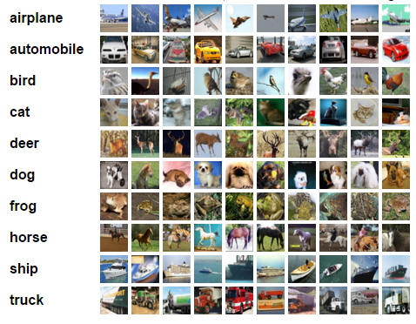
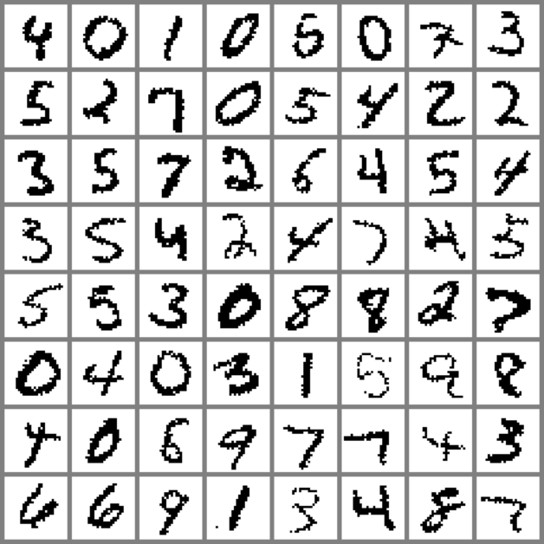
Prepared Datasets
Datasets
  CIFAR-10^{[1]}
  MNIST^{[2]}
Generate records
  Already done for you in virtualbox
    examples/cifar10/create_shard.cc
    examples/mnist/create_shard.cc
    # go to example folder
    $ cp Makefile.example Makefile
    $ make download # download raw data
    $make create # generate data records
[1] http://www.cs.toronto.edu/~kriz/cifar.html
[2] http://yann.lecun.com/exdb/mnist/

Slide 6
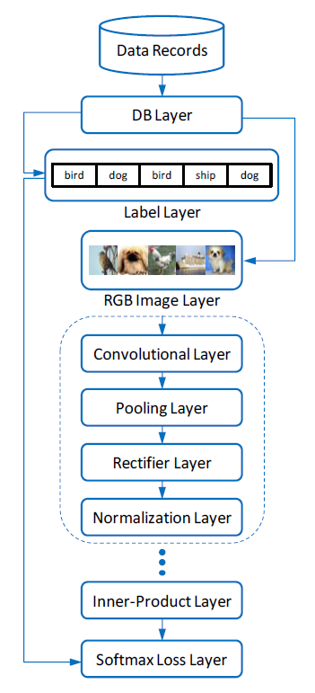
Examples (CNN)

Slide 7
Examples (CNN)
    layer {
    name: "data"
    type: kShardData
    sharddata_conf {
    path: "examples/cifar10/cifar10_train_shard"
    batchsize: 16
    random_skip: 5000
    }
    exclude: kTest # exclude for the testing net
    }
    layer {
    name: "data"
    type: kShardData
    sharddata_conf {
    path: "examples/cifar10/cifar10_test_shard“
    batchsize: 100
    }
    exclude: kTrain # exclude for the training net
    }

Slide 8
Examples (CNN)
    layer {
    name:"rgb"
    type: kRGBImage
    srclayers: "data"
    rgbimage_conf {
    meanfile: "examples/cifar10/image_mean.bin"
    # normalized image feature
    }
    }
    layer {
    name: "label"
    type: kLabel
    srclayers: "data"
    }

Slide 9
Examples (CNN)
    layer {
    name: "conv1"
    type: kConvolution
    srclayers: "rgb"
    convolution_conf { … }
    param {
    name: "w1"
    init { type: kGaussian }
    }
    param {
    name: "b1"
    lr_scale:2.0
    init { type: kConstant }
    }
    }

Slide 10
Examples (CNN)
    layer {
    name: "pool1"
    type: kPooling
    srclayers: "conv1"
    pooling_conf { … }
    }
    layer {
    name: "relu1"
    type: kReLU
    srclayers:"pool1"
    }
    layer {
    name: "norm1"
    type: kLRN
    srclayers:"relu1"
    lrn_conf { … }
    }

Slide 11
Examples (CNN)
    layer {
    name: "ip1"
    type: kInnerProduct
    srclayers:"pool3"
    innerproduct_conf { … }
    param { … }
    }
    layer {
    name: "loss"
    type: kSoftmaxLoss
    softmaxloss_conf { … }
    srclayers:"ip1“
    srclayers: "label“
    }

Slide 12
Configure a CNN Job
4 Main Components
  NeuralNet (as configured above)
  Updater
  TrainOneBatch
  ClusterTopology
    updater {
    type: kSGD
    learning_rate { type: kFixedStep }
    }
    alg: kBP

Slide 13
Run a CNN Job
A quick-start job
  Default ClusterTopology (single worker)
  Provided in
Run it!
    examples/cifar10/job.conf
    # start zookeeper (do it only once)
    $ ./bin/zk-service start
    # run the job using default setting
    $ ./bin/singa-run.sh -conf examples/cifar10/job.conf
    # stop the job
    $ ./bin/singa-stop.sh

Slide 14
Run a CNN Job
    Record job information to /tmp/singa-log/job-info/job-2-20150817-055601
    Executing : ./singa -conf /xxx/incubator-singa/examples/cifar10/job.conf -singa_conf /xxx/incubator-singa/conf/singa.conf -singa_job 2
    E0817 06:56:18.868259 33849 cluster.cc:51] proc #0 -> 192.168.5.128:49152 (pid = 33849)
    E0817 06:56:18.928452 33871 server.cc:36] Server (group = 0, id = 0) start
    E0817 06:56:18.928469 33872 worker.cc:134] Worker (group = 0, id = 0) start
    E0817 06:57:13.657302 33849 trainer.cc:373] Test step-0, loss : 2.302588, accuracy : 0.077900
    E0817 06:57:17.626708 33849 trainer.cc:373] Train step-0, loss : 2.302578, accuracy : 0.062500
    E0817 06:57:24.142645 33849 trainer.cc:373] Train step-30, loss : 2.302404, accuracy : 0.131250
    E0817 06:57:30.813354 33849 trainer.cc:373] Train step-60, loss : 2.302248, accuracy : 0.156250
    E0817 06:57:37.556655 33849 trainer.cc:373] Train step-90, loss : 2.301849, accuracy : 0.175000
    E0817 06:57:44.971276 33849 trainer.cc:373] Train step-120, loss : 2.301077, accuracy : 0.137500
    E0817 06:57:51.801949 33849 trainer.cc:373] Train step-150, loss : 2.300410, accuracy : 0.135417
    E0817 06:57:58.682281 33849 trainer.cc:373] Train step-180, loss : 2.300067, accuracy : 0.127083
    E0817 06:58:05.578366 33849 trainer.cc:373] Train step-210, loss : 2.300143, accuracy : 0.154167
    E0817 06:58:12.518497 33849 trainer.cc:373] Train step-240, loss : 2.295912, accuracy : 0.185417

Slide 15
SINGA Scripts
Launch singa jobs
Manage singa jobs
Stop all singa processes
    singa-run.sh -conf <job config file> [ other arguments ]
    -resume : if want to recover a job
    -exec <path to mysinga> : if want to use own singa driver
    singa-console.sh <command> <args>
    list : list running singa jobs
    view <job id> : view procs of a singa job
    kill <job id> : kill a singa job"
    singa-stop.sh

Slide 16
Run CNN (cont.)
Synchronous Training
  2 workers in a single process
Asynchronous Training
  downpour
  2 worker groups and 1 global server group
    # default setting
    cluster {
    nworker_groups: 1
    nserver_groups: 1
    nworkers_per_group: 1
    nservers_per_group: 1
    nworkers_per_procs: 1
    nservers_per_procs: 1
    server_worker_separate: false
    }
    cluster {
    nworkers_per_group: 2
    nworkers_per_procs: 2
    }
    cluster {
    nworker_groups: 2
    nservers_per_group: 2
    }

Slide 17
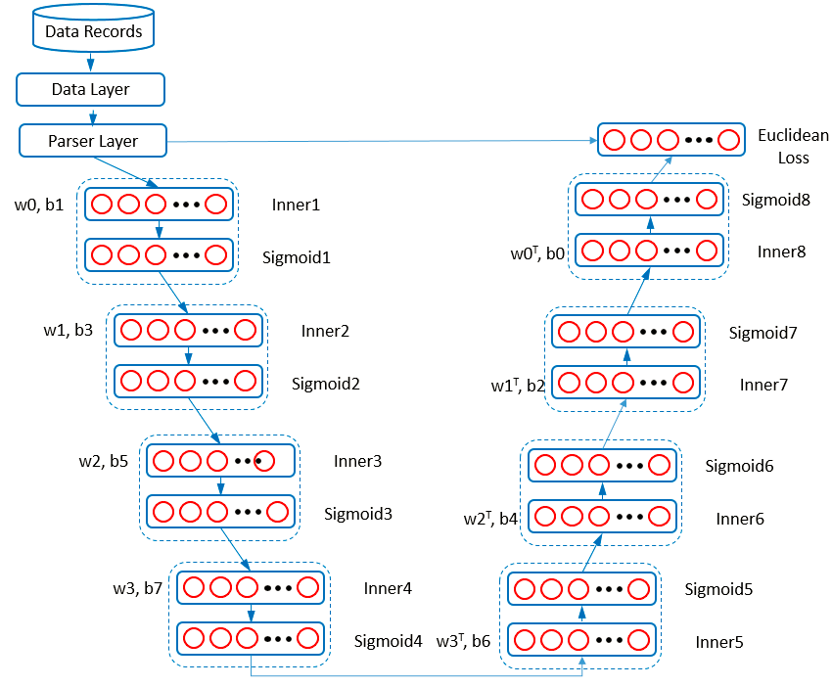
Examples (RBM-Auto Encoder)

Slide 18
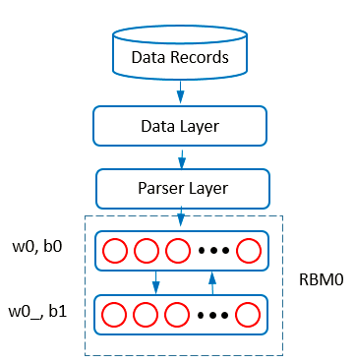
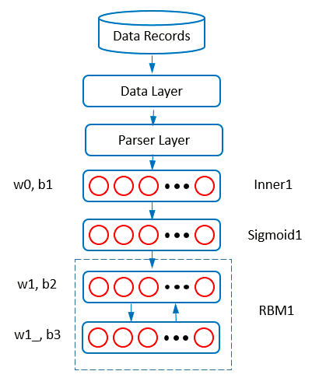
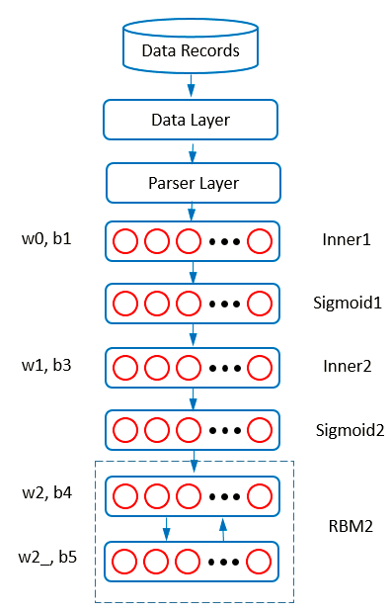
Examples (RBM-Auto Encoder)

Slide 19
Examples (RBM-Auto Encoder)
4 RBM and 1 Auto-encoder
  Need to pre-train models one by one
  How to use parameters from previous models?
    Check points are output files from a model
    When load check points for a new model, SINGA puts parameters values into the parameter with the same identity name
    checkpoint_path: "examples/rbm/rbm0/checkpoint/step6000-worker0.bin"

Slide 20
Run RBM-Auto Encoder
    # at SINGA_HOME/
    $ ./bin/singa-run.sh -conf examples/rbm/rbm0.conf
    $ ./bin/singa-run.sh -conf examples/rbm/rbm1.conf
    $ ./bin/singa-run.sh -conf examples/rbm/rbm2.conf
    $ ./bin/singa-run.sh -conf examples/rbm/rbm3.conf
    $ ./bin/singa-run.sh -conf examples/rbm/autoencoder.conf

Slide 21
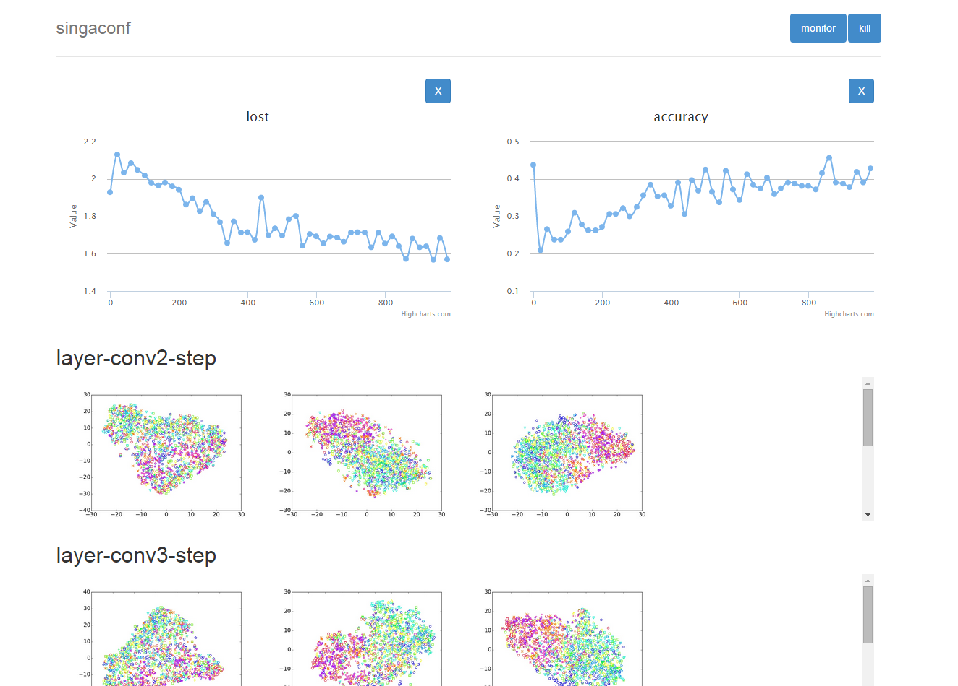
CNN-1
Notes:
Demo 3-1

Slide 22
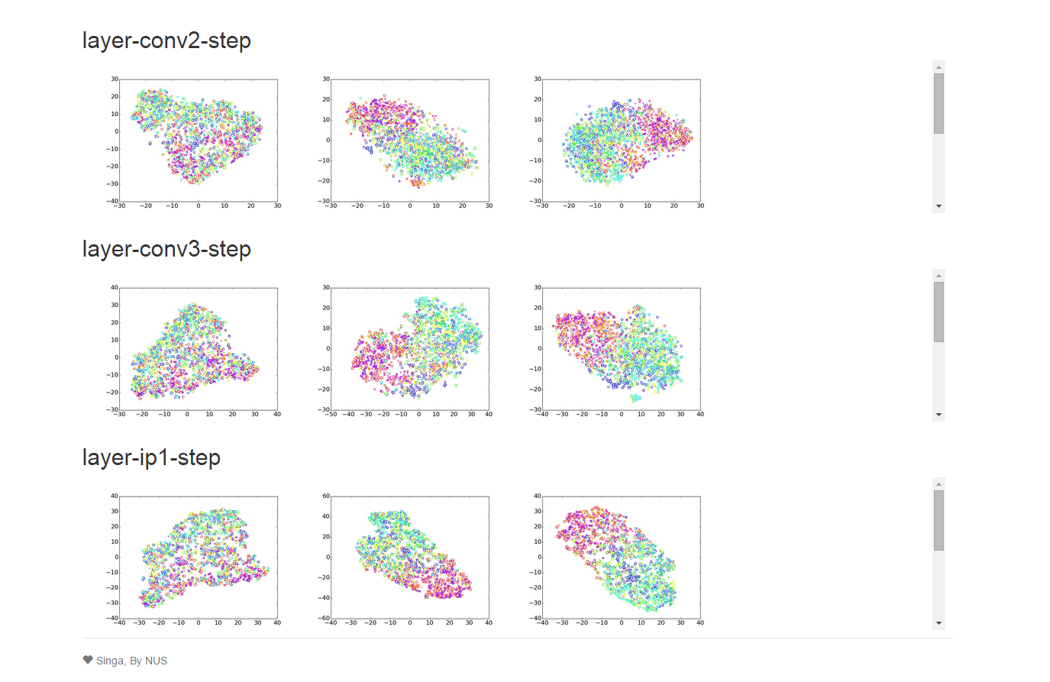
CNN-2
Notes:
Demo 3-2

Slide 23
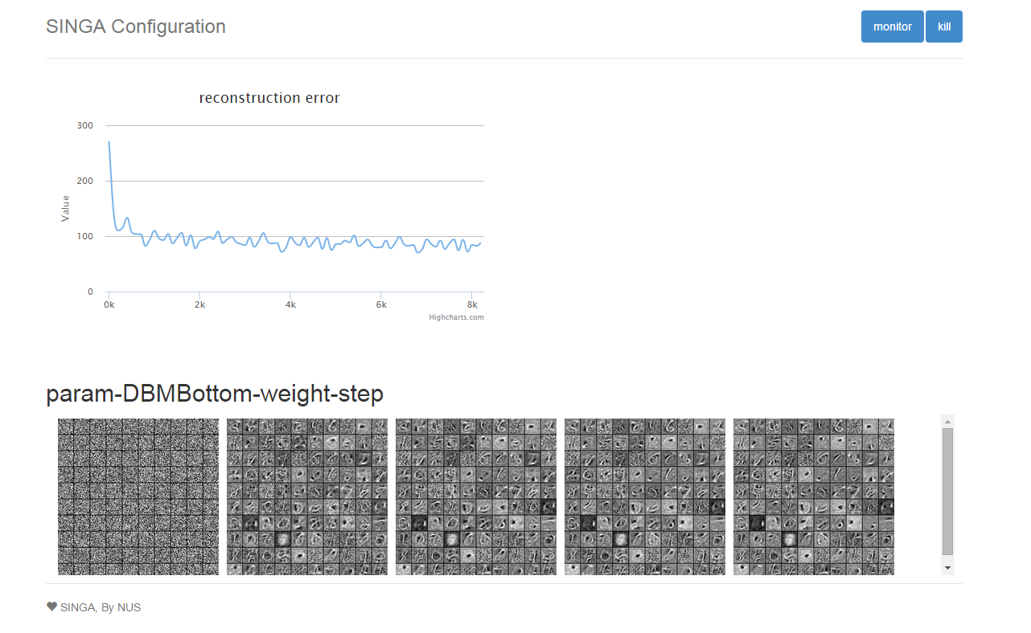
RBM

