Slide 1



Introduction to Apache Hivemall v0.5.0: Machine Learning on Hive/Spark
@ApacheHivemall
1). Principal Engineer,
Makoto YUI @myui
2). Research Engineer,
Takashi Yamamuro @maropu
Notes:
25min+20min+QA(5min)

Slide 2
Hive MAchine Learning Library
Hivemall is not only for Hive
Hivemall is not only for ML

Slide 3


Plan of the talk
Slide available: bit.ly/hivemall-montreal
Introduction to Hivemall
Hivemall on Spark
Background, quick walk-through of feature, usages, what's new in v0.5.0, and future roadmaps
New top-k join enhancement, and a feature plan for Supporting spark 2.3 and feature selection
Notes:
.

Slide 4
We released the first Apache release v0.5.0 on Mar 3rd, 2018 🎉
hivemall.incubator.apache.org
We plan to start voting for the 2nd Apache release (v0.5.2) in the next month (Oct 2018).

Slide 5
What’s new in v0.5.0?
Anomaly/Change Point
Detection
Topic Modeling
(Soft Clustering)
Hivmall on Spark
2.0/2.1/2.1
Algorithm:
ChangeFinder, SST
Algorithm:
LDA, pLSA
SparkSQL/Dataframe support,
Top-k data processing

Slide 6
Run machine learning on massive data stored on data warehouse
Background
Suppose …
Make
It!
Notes:
Suppose that your pointy-haired Boss ordered you to run machine learning …

Slide 7
Run machine learning on massive data stored on data warehouse
Concerns:
Scalability?
Data movement?
Tool?

Slide 8



Approach #1
Typical Data Scientist’s Solution
Data warehouse
Data preprocessing
Machine Learning
Small data?

Slide 9
Approach #2
Data Engineer’s Solution
Data warehouse
Data preprocessing
Machine Learning
Notes:
I guess some of you in this room are using this approach.

Slide 10
Q: Is Dataframe a great idea
for data (pre-)processing?
Notes:
Then, I would like to pose a question.

Slide 11
Q: Do you like it?
(for production-ready data preprocessing)
Yes
No
Maybe
I like it for simple data processing

Slide 12
Q: Do you really like it?
(for messy real-world data preprocessing)
Yes
No
Maybe

Slide 13
Real-world ML pipelines (could be more complex)
Datasource
#2
Datasource
#3
Datasource
#1
Predict
Evaluate
Extract Feature
Extract Feature
Train by
Logistic Regression
Join
Feature Selection
Feature Scaling
Train by
RandomForest
Ensemble
Feature Hashing
Train by
Factorization Machines
Feature Engineering

Slide 14
Q: Have you ever seen/write
hundreds-thousands lines of
preprocessing in Dataframe?
Hundreds-lines of SQL queries for data pre-processing are well seen

Slide 15
Q. Fun to play with it?
(scala/python coding for trivial things)
Do you write testing codes?
IMPO, notebook codes are error-prone for production uses

Slide 16

My Suggestion
+ Scalability
+ Durability/Stability
+ Functionalities
(UDFs, JSON, Windowing functions)
Data warehouse
Push more works back to
DB where data resides
(including some ML logics)
Data preprocessing
Machine Learning
One size does not fit all though ...

Slide 17


Machine Learning in SQL queries

Slide 18
BigQuery ML at Google I/O 2018
https://ai.googleblog.com/2018/07/machine-learning-in-google-bigquery.html

Slide 19


Could I use ML-in-SQL in my cluster?

Slide 20
Open-source Machine Learning Solution for SQL-on-Hadoop
https://hivemall.apache.org (incubating)

Slide 21
What is Apache Hivemall
Scalable machine learning library built as a collection of Hive UDFs
Ease-of-use
Scalable
Multi/Cross platform
Versatile

Slide 22
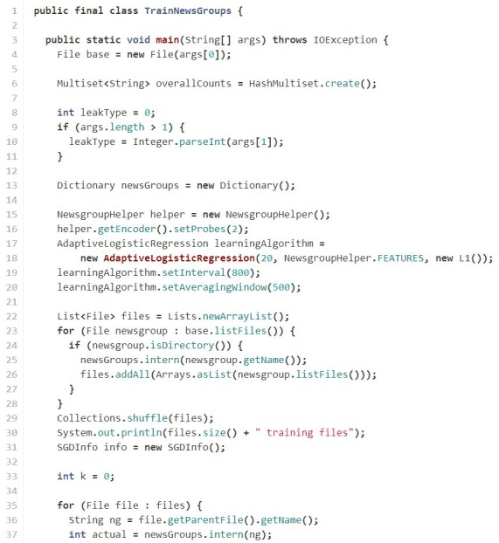
Hivemall is easy and scalable …
Ease-of-use
ML made easy for SQL developers
Born to be parallel and scalable
Scalable
CREATE TABLE lr_model AS
SELECT
feature, -- reducers perform model averaging in parallel
avg(weight) as weight
FROM (
SELECT logress(features,label,..) as (feature,weight)
FROM train
) t -- map-only task
GROUP BY feature; -- shuffled to reducers
100+ lines
of code
This query automatically runs in parallel on Hadoop

Slide 23
Hivemall is Multi/Cross platform ..
Multi/Cross platform
Hivemall is a multi/cross-platform ML library
prediction models built by Hive can be used from Spark, and conversely, prediction models build by Spark can be used from Hive
HiveQL
SparkSQL/Dataframe API
Pig Latin

Slide 24
Hivemall’s Technology Stack
Machine Learning
Hivemall
MLlib
Query Processing
Hive
Pig
SparkSQL
Parallel Data
Processing Framework
MapReduce
(MRv1)
Apache Tez
DAG processing
Apache Spark
Apache YARN
MESOS
Resource Management
Distributed File System
Cloud Storage
Hadoop HDFS
Amazon S3

Slide 25
Hivemall on Apache Hive

Slide 26
Hivemall on Apache Spark Dataframe

Slide 27
Hivemall on SparkSQL

Slide 28
Hivemall on Apache Pig

Slide 29
Online Prediction by Apache Streaming

Slide 30
List of Supported Algorithms
Classification
  Perceptron
  Passive Aggressive (PA, PA1, PA2)
  Confidence Weighted (CW)
  Adaptive Regularization of Weight Vectors (AROW)
  Soft Confidence Weighted (SCW)
  AdaGrad+RDA
  Factorization Machines
  RandomForest Classification
Regression
  Logistic Regression (SGD)
  AdaGrad (logistic loss)
  AdaDELTA (logistic loss)
  PA Regression
  AROW Regression
  Factorization Machines
  RandomForest Regression
Logistic regression is good for getting a probability of a positive class
Factorization Machines is good where features are sparse and categorical ones
SCW is a good first choice
Try RandomForest if SCW does not work

Slide 31
Generic Classifier/Regressor
OLD Style
New Style from v0.5.0

Slide 32
Generic Classifier/Regressor
Available Loss functions
Regularization
Optimizer
For Binary Classification:
L1
L2
ElasticNet
RDA
SGD
AdaGrad
AdaDelta
ADAM
HingeLoss
LogLoss (synonym: logistic)
SquaredHingeLoss
ModifiedHuberLoss
For Regression:
Other options
Squared Loss
Quantile Loss
Epsilon Insensitive Loss
Squared Epsilon Insensitive Loss
Huber Loss
Iteration support
mini-batch
Early stopping

Slide 33
RandomForest in Hivemall
Ensemble of Decision Trees

Slide 34
Training of RandomForest
Good news: Sparse Vector Input (Libsvm format) is supported since v0.5.0 in addition Dense Vector input.

Slide 35
Prediction of RandomForest

Slide 36
Decision Tree Visualization

Slide 37
Decision Tree Visualization

Slide 38
XGBoost support in Hivemall (beta version)
SELECT train_xgboost_classifier(features, label) as (model_id, model)
FROM training_data
SELECT rowed, AVG(predicted) as predicted
FROM (
-- predict with each model
SELECT xgboost_predict(rowid, features, model_id, model) AS (rowid, predicted)
-- join each test record with each model
FROM xgboost_models CROSS JOIN test_data_with_id
) t
GROUP BY rowid;

Slide 39
Supported Algorithms for Recommendation
K-Nearest Neighbor
  Minhash and b-Bit Minhash
  (LSH variant)
  Similarity Search on Vector Space
  (Euclid/Cosine/Jaccard/Angular)
Matrix Completion
  Matrix Factorization
  Factorization Machines (regression)
each_top_k function of Hivemall is useful for recommending top-k items

Slide 40
Other Supported Algorithms
Feature Engineering
  Feature Hashing
  Feature Scaling
  (normalization, z-score)
  Feature Binning
  TF-IDF vectorizer
  Polynomial Expansion
  Amplifier
Evaluation metrics
  AUC, nDCG, logloss, precision recall@K, and etc
NLP
  Basic Englist text Tokenizer
  English/Japanese/Chinese Tokenizer

Slide 41
Feature Engineering – Feature Hashing

Slide 42
Evaluation Metrics

Slide 43
Other Supported Features
Anomaly Detection
  Local Outlier Factor (LoF)
  ChangeFinder
Change Point Detection
  ChangeFinder
  Singular Spectrum Transformation
Clustering / Topic models
  Online mini-batch LDA
  Online mini-batch PLSA

Slide 44
Anomaly/Change-point Detection by ChangeFinder
Efficient algorithm for finding change point and outliers from time-series data
J. Takeuchi and K. Yamanishi, “A Unifying Framework for Detecting Outliers and Change Points from Time Series,” IEEE transactions on Knowledge and Data Engineering, pp.482-492, 2006.

Slide 45
Anomaly/Change-point Detection by ChangeFinder
Take this…

Slide 46
Anomaly/Change-point Detection by ChangeFinder
…and do this!

Slide 47
Change-point detection by Singular Spectrum Transformation
T. Ide and K. Inoue, "Knowledge Discovery from Heterogeneous Dynamic Systems using Change-Point Correlations", Proc. SDM, 2005T.
T. Ide and K. Tsuda, "Change-point detection using Krylov subspace learning", Proc. SDM, 2007.

Slide 48
Online mini-batch LDA

Slide 49
Probabilistic Latent Semantic Analysis - training

Slide 50
Probabilistic Latent Semantic Analysis - predict

Slide 51
What’s new in the coming v0.5.2
Spark 2.3 support
Merged Brickhouse UDFs
Field-aware Factorization Machines
SLIM recommendation
State-of-the-art method for CTR prediction, often used algorithm in Kaggle
Yuchin Juan, Yong Zhuang, Wei-Sheng Chin, and Chih-Jen Lin, "Field-aware Factorization Machines for CTR Prediction", Proc. RecSys. 2016.
Very promising algorithm for top-k recommendation
Xia Ning and George Karypis, SLIM: Sparse Linear Methods for Top-N Recommender Systems, Proc. ICDM, 2011.

Slide 52
Future work for v0.6 and later
Word2Vec support
Multi-class Logistic Regression
More efficient XGBoost support
LightGBM support
Gradient Boosting
Kafka KSQL UDF porting
PR#116
PR#91

Slide 53
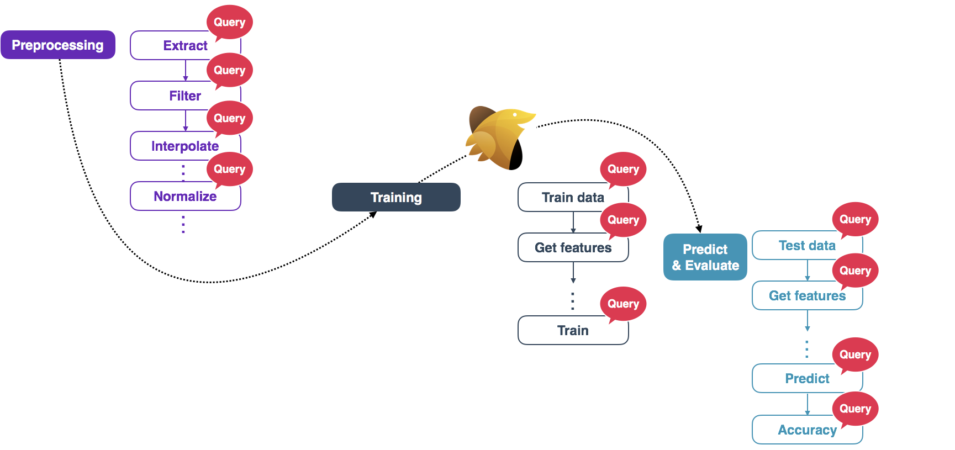
Whatever you like
Apache Hivemall Digdag (or Apache Airflow)
digdag.io

Slide 54
github.com/treasure-data/workflow-examples
github.com/myui/dockernized-digdag-server
ML pipeline in YAML

Slide 55

Hivemall on

Slide 56

Who am I
NTT corp. in Tokyo, Japan
You can find all my activities in...
  https://github.com/maropu

Slide 57
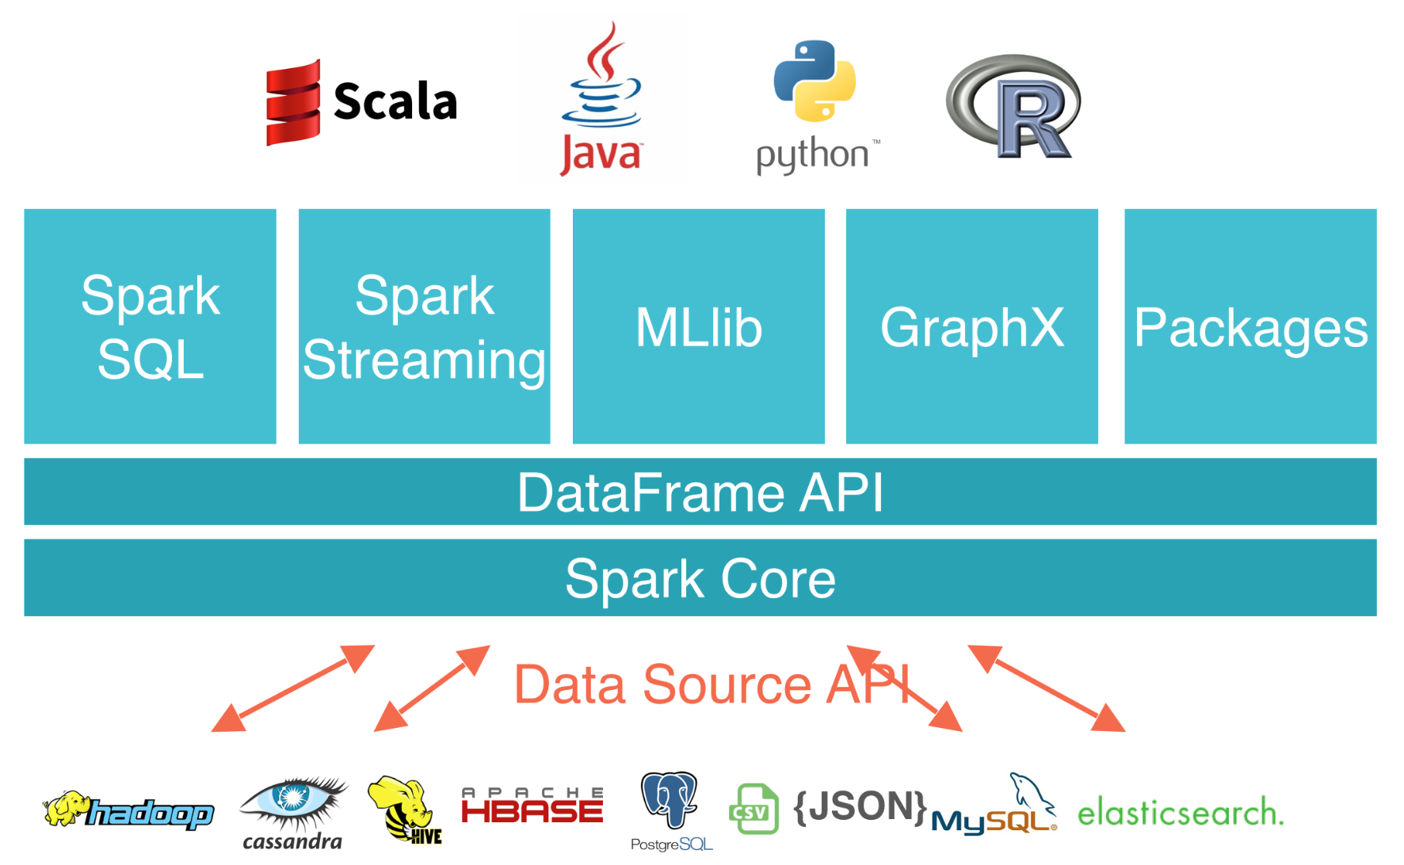
Apache Spark: Distributed Analytics Engine
Unified Engine
  supports end-to-end APIs, e.g., MLlib and Streaming
High-Level APIs
  easy-to-use, rich
  optimization
Integrates Broadly
  storages, libraries, ...

Slide 58
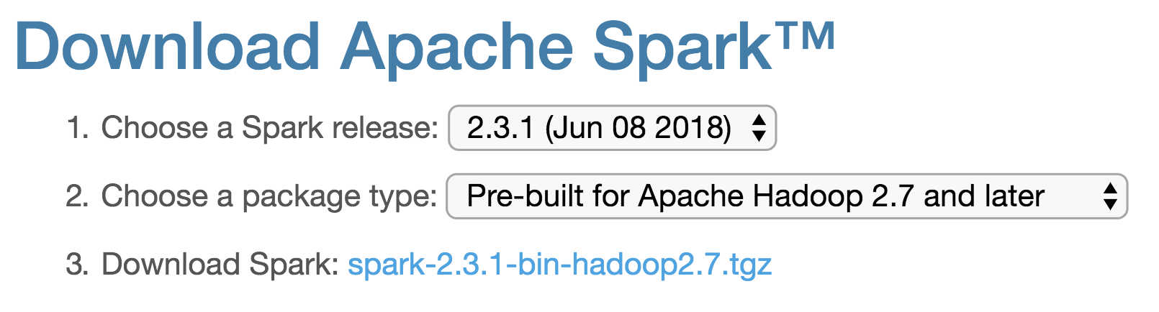
Quick Start: Word Counting
1. Downloads pre-built Spark
2. Launches an interactive shell
3. Then, counts words
https://spark.apache.org/downloads.html
$ ./bin/spark-shell
scala> val file = spark.read.textFile("README.md")
scala> file.filter(_.contains(“Spark”)).count()
res2: Long = 15

Slide 59
Spark Recent Status
Latest is v2.3.1 and v2.4.0 will be available soon (feature freeze done)
New features in v2.3*
  Continuous Processing
  Spark on Kubernetes (Experimental)
  Streaming Machine Learning
  Image Reader
  …
  * Further information can be found in https://bit.ly/2xa5y1H

Slide 60
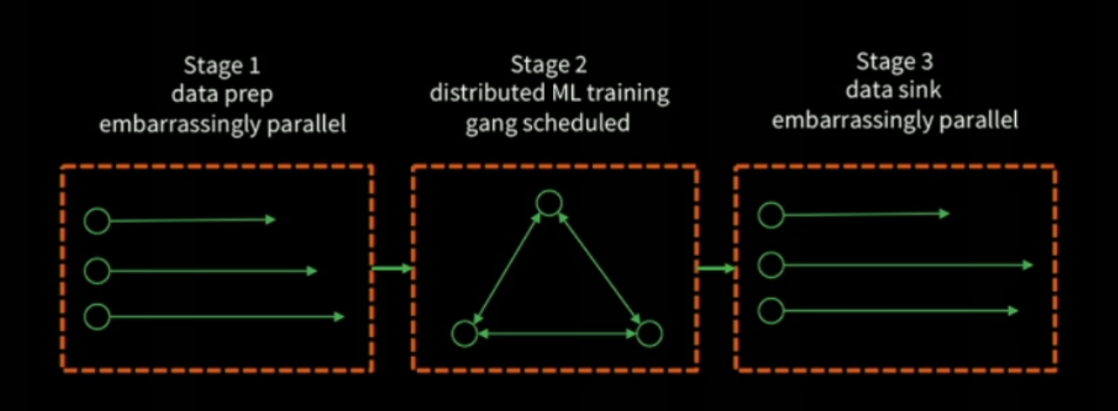
Spark Recent Status
Ongoing Major Work: Project Hydrogen
  State-of-the-Art Deep Learning on Apache Spark
  * Unified execution models with Hydrogen, cited from https://bit.ly/2QvA3rI

Slide 61
What’s Hivemall on Spark?
Hivemall wrapper for Spark
  Wrapper implementations for DataFrame/SQL
  + Some utilities for easy-to-use in Spark
The wrapper makes you...
  run most of Hivemall functions in Spark
  try examples easily in your laptop
  improve some function performance in Spark

Slide 62
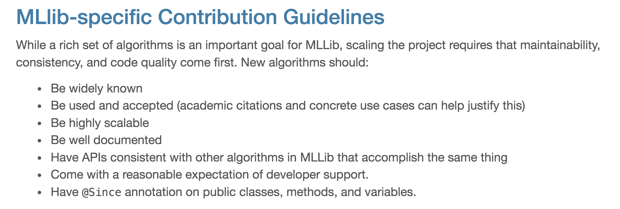
Why’s Hivemall on Spark?
Hivemall already has many fascinating ML algorithms and useful utilities
  + High barriers to add newer algorithms in MLlib
http://spark.apache.org/contributing.html

Slide 63
Current Support Status
Most of Hivemall functions supported in Spark v2.3 (HIVEMALL-179), v2.2, and v2.1
  To compile from source codes, ...
$ git clone https://github.com/apache/incubator-hivemall
$ cd incubator-hivemall
$ mvn package –DskipTests
$ ls target/*spark*
target/hivemall-spark2.3-0.5.1-XXX-with-dependencies.jar
...

Slide 64
Example
1. Fetches training and test data
2. Loads these data in Spark
3. Builds a model
4. Does predictions

Slide 65
Example: 1. Fetches training and test data
E2006 tfidf regression dataset
  http://www.csie.ntu.edu.tw/~cjlin/libsvmtools/datasets/regression.html#E2006-tfidf
$ wget http://www.csie.ntu.edu.tw/~cjlin/libsvmtools/datasets/
regression/E2006.train.bz2
$ wget http://www.csie.ntu.edu.tw/~cjlin/libsvmtools/datasets/
regression/E2006.test.bz2

Slide 66
Example: 2. Loads data in Spark
// Downloads Spark v2.3 and launches a spark-shell with Hivemall
$ ./bin/spark-shell --jars <
// Create DataFrame from the bzip’d libsvm-formatted file
scala> val trainDf = spark.read.format("libsvm”).load(“E2006.train.bz2")
scala> trainDf.printSchema
root
|-- label: double (nullable = true)
|-- features: vector (nullable = true)

Slide 67
Example: 3. Builds a model - DataFrame
scala> paste:
val modelDf = trainDf.train_logregr($"features", $"label")
.groupBy("feature”)
.agg("weight" -> "avg”)

Slide 68
Example: 3. Builds a model - SQL
scala> trainDf.createOrReplaceTempView("TrainTable")
scala> paste:
val modelDf = sql("""
| SELECT feature, AVG(weight) AS weight
| FROM (
| SELECT train_logregr(features, label)
| AS (feature, weight)
| FROM TrainTable
| )
| GROUP BY feature
""".stripMargin)

Slide 69
Example: 4. Does predictions - DataFrame
scala> paste:
val df = testDf.select(rowid(), $"features")
.explode_vector($"features")
.cache
# Do predictions
df.join(modelDf, df("feature") === model("feature"), "LEFT_OUTER")
.groupBy("rowid")
.avg(sigmoid(sum($"weight" * $"value")))

Slide 70
Example: 4. Does predictions - SQL
scala> modelDf.createOrReplaceTempView(”ModelTable")
scala> df.createOrReplaceTempView(”TestTable”)
scala> paste:
sql("""
| SELECT rowid, sigmoid(value * weight) AS predicted
| FROM TrainTable t
| LEFT OUTER JOIN ModelTable m
| ON t.feature = m.feature
| GROUP BY rowid
""".stripMargin)

Slide 71
Useful Function Extension: Top-K Processing
Top-K processing is widely used, e.g., recommendation
Hivemall ‘each_top_k’ available in DataFrame
  Naïve approach: SQL rank over + limit
scala> df.printSchema
root
|-- key: string (nullable = true)
|-- value: string (nullable = true)
|-- x: double (nullable = false)
scala> df.each_top_k(lit(3), $"x".as("score"), $"key".as("group"))
// Computes top-3 entries for each group

Slide 72
Useful Function Extension: Top-K Processing
Common Pattern: Join->Top-K
  Joins two relations, then computes top-K for each group
Computes top-K by using Spark vanilla APIs only
scala> paste:
val topkDf = leftDf.join(rightDf, “group” :: Nil, “INNER”)
.select(leftDf("group"), (leftDf(“x”) + rightDf(“y”)).as(“score”)
.withColumn(
"rank", rank().over(partitionBy($"group”).orderBy($"score".desc)))
.where($"rank" <= topK)

Slide 73
Useful Function Extension: Top-K Processing
Common Pattern: Join->Top-K
  Joins two relations, then computes top-K for each group
Computes top-K by using Spark vanilla APIs only
scala> paste:
val topkDf = leftDf.join(rightDf, “group” :: Nil, “INNER”)
.select(leftDf("group"), (leftDf(“x”) + rightDf(“y”)).as(“score”)
.withColumn(
"rank", rank().over(partitionBy($"group”).orderBy($"score".desc)))
.where($"rank" <= topK)
1. Joins leftDf with rightDf
2. Sort data in each group
3. Filter top-K data

Slide 74
Useful Function Extension: Top-K Processing
Common Pattern: Join->Top-K
  Joins two relations, then computes top-K for each group
Implements an efficient fused API in Hivemall
scala> paste:
val topkDf = leftDf.top_k_join(
lit(topK), rightDf, leftDf(“group”) === rightDf(“group”),
(leftDf(“x”) + rightDf(“y”)).as(“score”)
)

Slide 75
Useful Function Extension: Top-K Join
How does ‘top_k_join’ works?
group | y
group | x
・・・
leftDf
rightDf

Slide 76
Useful Function Extension: Top-K Join
How does ‘top_k_join’ works?
Computes top-K rows
by using a priority queue
group | y
group | x
・・・
K-length
priority queue
・・・
leftDf
rightDf

Slide 77
Useful Function Extension: Top-K Join
How does ‘top_k_join’ works?
Computes top-K rows
by using a priority queue
group | y
group | x
・・・
K-length
priority queue
・・・
leftDf
Only joins top-K rows
rightDf

Slide 78
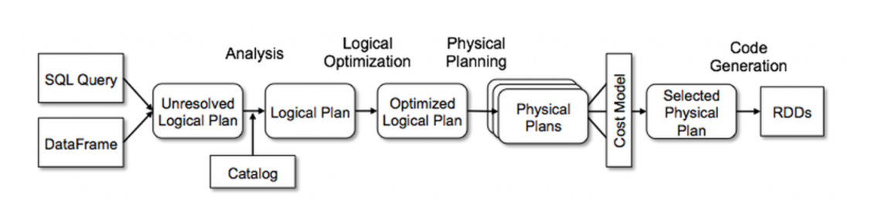
Useful Function Extension: Top-K Join
Codegen’d ‘top_k_join’ for fast processing
  Spark internally generates Java code from a built physical plan, and compiles/executes it
Spark Planner (Catalyst) Overview

Slide 79
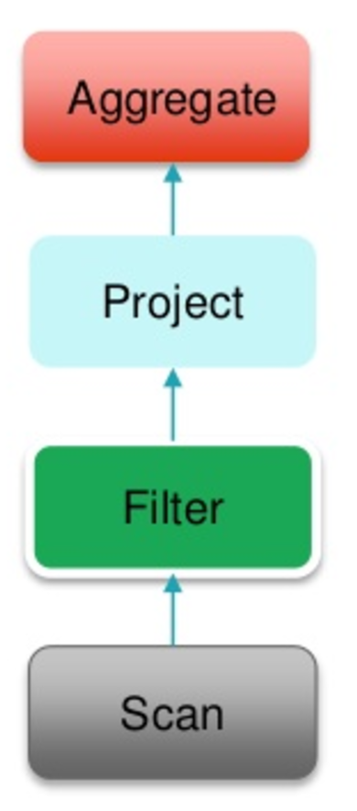
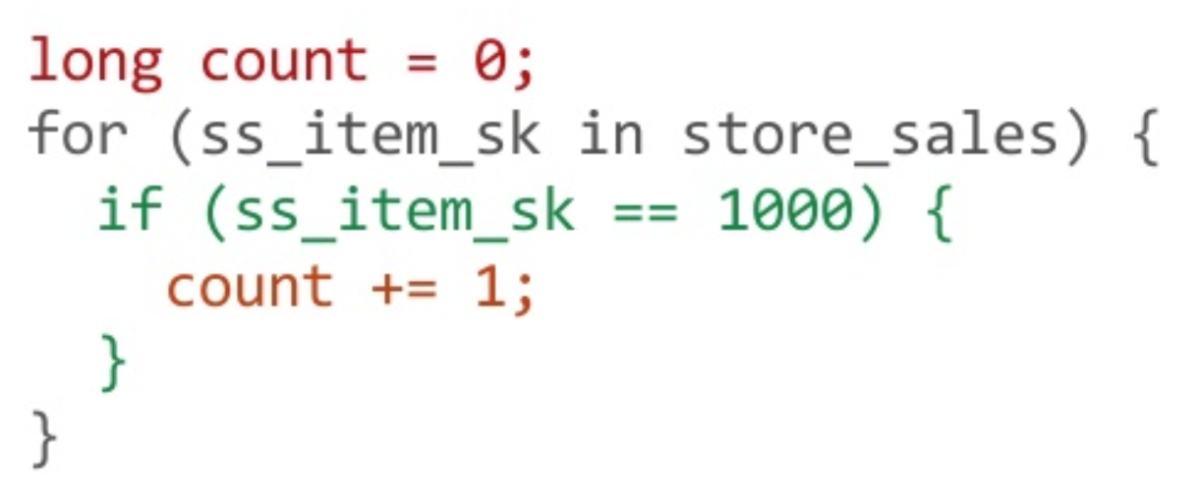
Useful Function Extension: Top-K Join
Codegen’d ‘top_k_join’ for fast processing
  Spark internally generates Java code from a built physical plan, and compiles/executes it
Codegen
Physical Plan

Slide 80
Useful Function Extension: Top-K Join
Codegen’d ‘top_k_join’ for fast processing
  Spark internally generates Java code from a built physical plan, and compiles/executes it
scala> topkDf.explain
== Physical Plan ==
*ShuffledHashJoinTopK 1, [group#10], [group#27]
:- Exchange hashpartitioning(group#10, 200)
: +- LocalTableScan [group#10, x#11]
+- Exchange hashpartitioning(group#27, 200)
+- LocalTableScan [group#27, y#28]
‘*’ in the head means a codegen’d plan

Slide 81
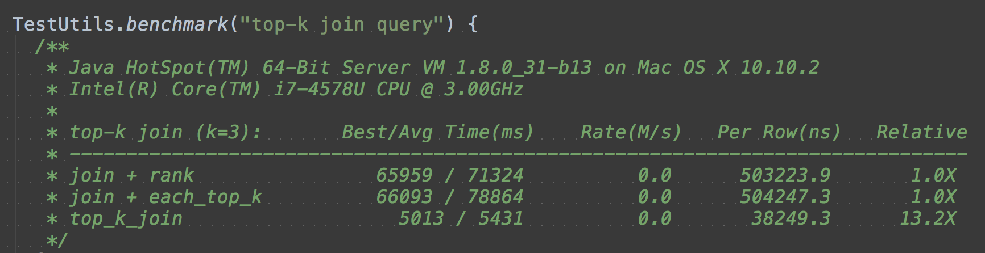
Useful Function Extension: Top-K Join
Benchmark Results
~13 times faster than the other two cases!!

Slide 82
WIP: Plan Re-writing for Feature Selection
Feature Selection + Spark Optimizer = Fast Data Extraction
  HIVEMALL-181: Plan rewriting rules to filter meaningful training data before feature selections
Arun Kumar, Jeffrey Naughton, Jignesh M. Patel, and Xiaojin Zhu, To Join or Not to Join?: Thinking Twice about Joins before Feature Selection, Proceedings of SIGMOD, 2016.

Slide 83
WIP: Plan Re-writing for Feature Selection
Feature Selection + Spark Optimizer = Fast Data Extraction
  HIVEMALL-181: Plan rewriting rules to filter meaningful training data before feature selections
Arun Kumar, Jeffrey Naughton, Jignesh M. Patel, and Xiaojin Zhu, To Join or Not to Join?: Thinking Twice about Joins before Feature Selection, Proceedings of SIGMOD, 2016.

Slide 84
Conclusion and Takeaway
Hivemall is a multi/cross-platform ML library
providing a collection of machine learning algorithms as Hive UDFs/UDTFs
HiveQL
SparkSQL/Dataframe API
Pig Latin
The 2nd Apache release (v0.5.2) will appear soon!
We welcome your contributions to Apache Hivemall ☺

Slide 85

Thank you! Questions?
BTW, mentors wanted!

