Slide 1
Streaming Media at Scale
The Story of Apache Traffic Control
Dave Neuman, Comcast
neuman@apache.org

Slide 2
A set of components that can be used to build, ​monitor, configure,
and provision a large-scale content delivery network (CDN).​

Slide 3
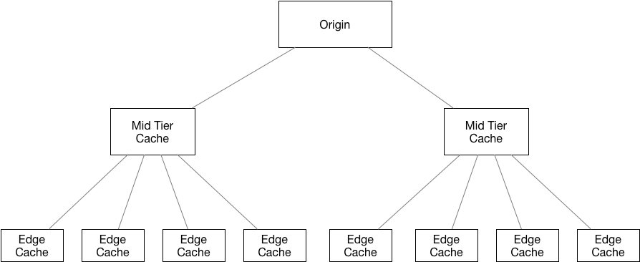
A CDN is a distributed system of servers used for delivering content over HTTP(s).
Notes:
Content Delivery Network (CDN) traffic will carry 71 percent of all Internet traffic by 2021. Seventy-one percent of all Internet traffic will cross CDNs by 2021 globally, up from 52 percent in 2016.
Internet video to TV grew 50 percent in 2016. Internet video to TV will continue to grow at a rapid pace, increasing 3.6-fold by 2021. Internet video-to-TV traffic will be 26 percent of consumer Internet video traffic by 2021, up from 24 percent in 2016.
https://www.cisco.com/c/en/us/solutions/collateral/service-provider/visual-networking-index-vni/complete-white-paper-c11-481360.html

Slide 4
Caches
The HTTP standards compliant work horses of the CDN; deployed in multiple tiers and locations
Traffic Router
Routes clients to the best available cache in their location for their content using HTTP(s) redirects or DNS
Health protocol
Monitors caches for system and application metrics and use that data to make health decisions about caches in the CDN
Configuration Management
Provides the ability to manage users, configuration files, servers, and topology via an API or UI
Logging and analytics
Collect and index logs for all servers in the CDN making them available for search and analysis
Caches
Logging & Analytics
Traffic Router
Health Protocol
Configuration Management

Slide 5
The story begins

Slide 6
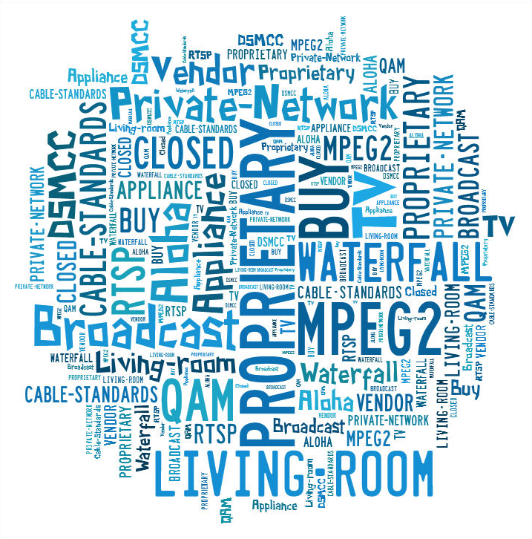
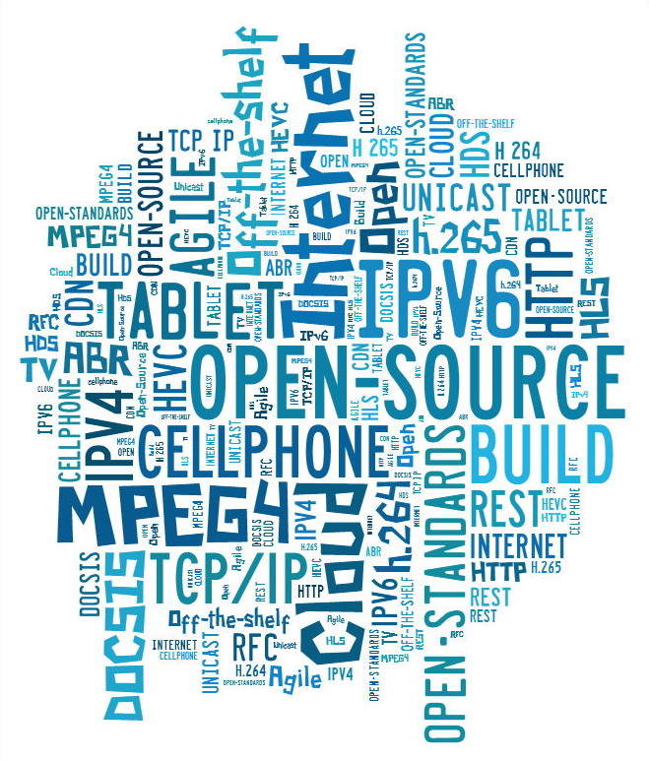
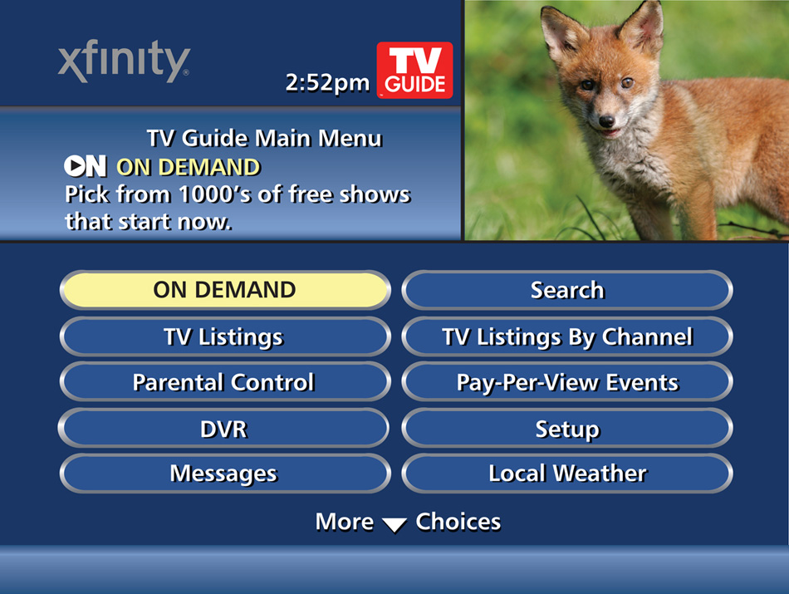
We Need a CDN!

Slide 7
Traffic Control design principles
Leverage open source software, common hardware, and industry standards wherever possible
All customer facing parts are IPv4 and IPv6
Horizontally scalable with loosely coupled components to achieve 100% availability
Maintenance, testing, and outages are a part of normal life

Slide 8
Our journey to TLP
JANUARY: Comcast and Cox announce a deal to bring the X1 platform (including CDN) to Cox
JULY: Traffic Control enters the Apache Incubator!
12 Committers
3 companies
May: Traffic Control Graduates to a TLP!
16 Committers
6 Companies
2012
2015
2017
2014
2016
2018
JANUARY: Work begins on the IPCDN
MAY: Comcast begins National roll out of the X1 Platform
OCTOBER: IPCDN is in Production!
APRIL: Traffic Control is open sourced!
DECEMBER: Four confirmed installs, Five external contributors
FEBRUARY: First release through the Incubator!

Slide 9
How are we doing?
19 Committers representing 7 different companies
1800+ Pull Requests Merged
5 releases since joining the incubator
9000+ commits
70+ contributors
450+ Open issues
60+ Pull requests
Majority of the development from one company

Slide 10
Apache Traffic Control CDNs serve:
More than 35 petabytes per day
1.5 libraries of congress per minute​
​
More than 100 billion transactions/day
> 1 million TPS​
​
More than 18 exabytes served in total​
Exabyte = 1,000,000,000,000,000,000 bytes

Slide 11
Why ASF?
Friendly To Contributors​​
• No Corporate CLA​​
​​
Provides Mentorship To New Projects​​
• Apache Incubator​​
• Roadmap for success (or not)
• Mentors​​​​
​​
Bootstrap Infrastructure​​
• Infra Team​​
• Jenkins CI/CD​​
• Mailing Lists​

Slide 12
Why ASF?
The Apache Way
Charity​​​​
Pragmatic​​​​
Openness​​​​
Meritocracy​​​​
Consensus​​​​
Community Over Code​

Slide 13
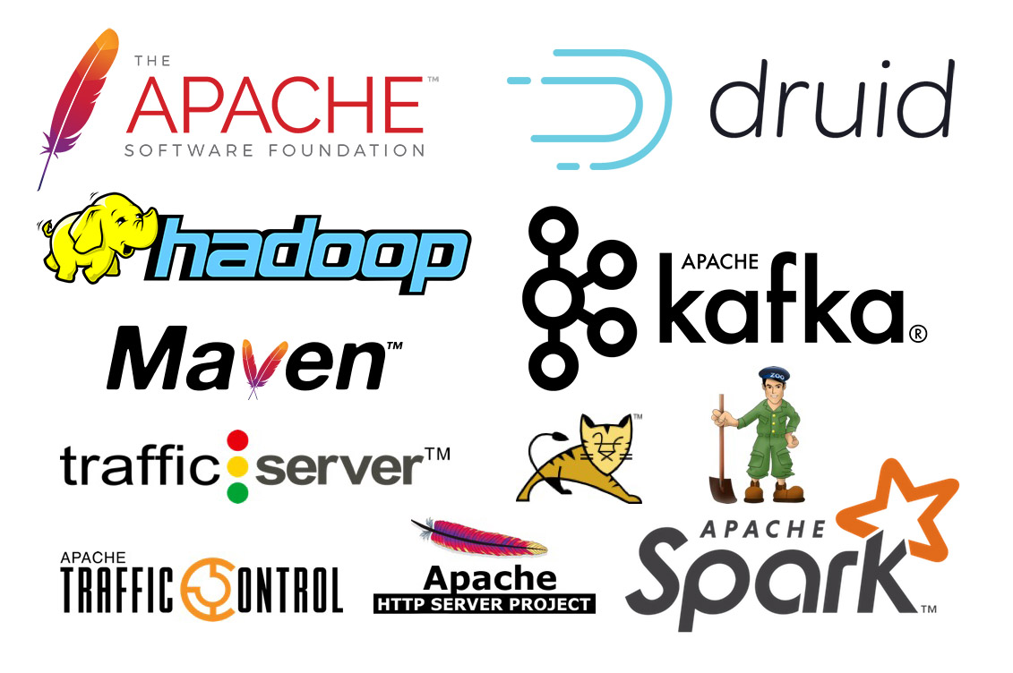
Apache Projects we use & love

Slide 14
Congratulations Traffic Control!

