Slide 1
Apache HAWQ on Kubernetes
Bring SQL on Hadoop to Cloud
Wen Lin, Ivan Weng
@Pivotal

Slide 2
About Us:
Ivan Weng
Principal Software Engineer at Pivotal, Beijing
Apache HAWQ Committer, PMC member
iweng@pivotal.io
Wen Lin
Staff Software Engineer at Pivotal, Beijing
Apache HAWQ Committer, PMC member
wlin@pivotal.io

Slide 3
Agenda
What is Apache HAWQ
HAWQ Architecture / Highlights
HAWQ integration with Kubernetes
Q & A

Slide 4
What is Apache HAWQ
A Hadoop native SQL query engine that combines the merit of Massively Parallel Processing database(Greenplum Database) and Hadoop distributed storage(HDFS).
Open source, Apache License 2.0
Notes:
Greenplum database as a mature enterprise olap database is good at performance, interactive queries, standard compliance, query optimizer. On the other hand HDFS is good at fault tolerance and scalability. HAWQ adopts advancement of the two products.
Unlike Greenplum, HAWQ data are stored on HDFS.

Slide 5
HAWQ Highlights
Robust SQL compliance, JDBC/ODBC, BI/Visualization Tools
Hadoop Native: storage (HDFS), resource management (YARN), deployment (Ambari), role management(Ranger).
Fine-grained resource management, hierarchical resource queues(DDL)
Elastic execution engine
High performance
World-class parallel optimizer(GPORCA)
Dynamic node expansion/shrink
Advanced machine learning and data mining functionalities through MADLib
Notes:
SQL-92, SQL-99, SQL-2003, OLAP extension, HAWQ can execute 99 queries in TPC-DS benchmark.
Provides hierarchical resource queues, the resource queues are created and managed by DDL SQL statement.
DB admin create source resource queues, each resource queue can consume certain percentage of whole cluster resource. every user in database is assigned to a resource queue. That user’s query use resource following the resource queue definition.
Elastic execution engine: In some MPP database no matter the query cost is large or small.
Cost-Based Query Optimizer

Slide 6
HAWQ: Past and Now
2011: Prototype: GoH (Greenplum on HDFS)
2012: HAWQ 1.0 Alpha
2013 ~ 2014: HAWQ 1.0/1.x
2015: HAWQ 2.0 Beta & Apache incubating
2016: HAWQ 2.0, Resource Manager, Integrate with YARN, Elastic computing engine
2017 ~ 2018: Performance/Security enhancement(TDE)
2018/8: Graduate as a ASF Top-Level Project
~ 1570 commits
45 committers and PMC members
latest version: 2.4.0.0 (Pluggable vectorized execution engine, Bloom Filter for Hash Join)
http://hawq.apache.org
https://github.com/apache/hawq/
Notes:
2016 is a significant year to HAWQ, design and implement the resource manager and elastic computing engine. At this moment, HAWQ can be considered to achieve the separation of compute and storage.
2017: Hawq supports HDFS TDE (Transparent Data Encryption)
Since hawq became the incubating project of apache... health status.

Slide 7
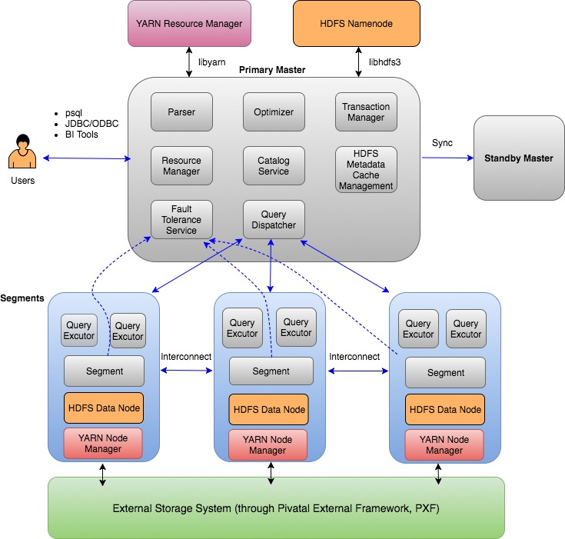
HAWQ High-level Architecture
Notes:
HAWQ is a typical MPP shared-nothing architecture. A Hawq cluster contains three kinds of nodes, one primary master, one standby master, and some segment. They are connected via high-speed networks.
master is the brain of the whole cluster, standby master provide High availability for primary master, segments are workers.
In terms of deployment, a hawq segment instance will be installed and running in a physical node or virtual machine. Segment instance forks query executor processes to execute the query plan.
HAWQ primary master and standby master are synced by Write Ahead Log shipping. That means every change to the catalog or metadata of master, the log of this change will be shipped standby master, standby master replay the log, the keep the database status synced with primary master, once primary.
Resource manager mainly deal with three thing.
The first is resource pool management;
the second is resource queue management;
The last is resource scheduling, when concurrent queries come, the resource manager will allocate resource for each query based on the definition of resource queue and current available resource in resource pool. So the resource allocation for queries are determined by many factors, all these logic are handled by HAWQ Resource Manager.

Slide 8
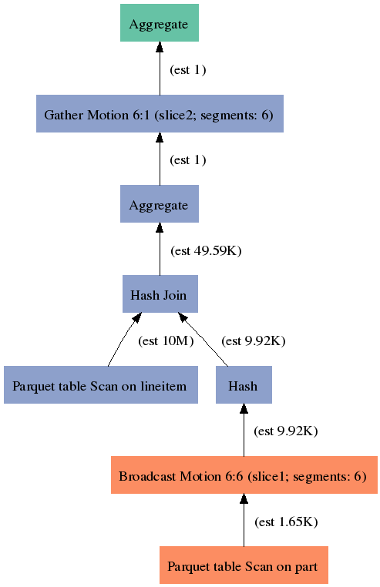
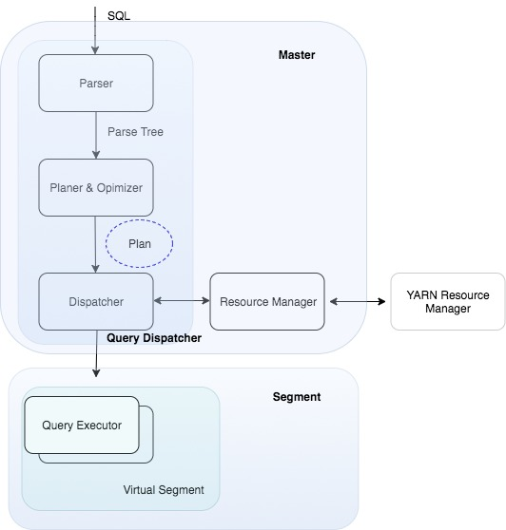
How a Query Is Executed in HAWQ
Slice:
1. a portion of the plan that segments can work on independently.
2. a query plan is sliced wherever a motion operation occurs in the plan.
Motion:
1. an operation involves moving tuples between the segments during query processing.
2. three types: redistribution, broadcast, gather motion.
Virtual Segment:
1. a resource unit for QD and Resource Manager
2. an execution unit
3. VSEG number determines the degree of parallelism of a query.
SELECT COUNT(*) FROM lineitem, part WHERE p_partkey=l_partkey AND p_brand = 'Brand#23'
Notes:
When a query comes, HAWQ master forks a query dispatcher process to serve this request. QD will process this query step by step. Parser Plan and optimizer. Different join order are different query plan, has different query cost. Optimizer is to find the best query plan.
QD dispatch the plan to QE. The plan is self-describing. Segment is stateless. all metadata is stored in master. The plan itself contains all the metadata information.
There is new term here, virtual segment.
A virtual segment is an execution unit, it behaves like a container for QEs.
Each virtual segment has some QE processes executing for one query.
(Each virtual segment has one QE for each slice of a query)
VSeg number determines the DOP, the more VSEG allocated for this query, the more parallel QE processes will run for this query.
The executor executes plans in a pipeline manner and the final results are sent back to the master and presented to clients.
Broadcast Motion (N:N): Every segment sends the input tuples to all other segments.
Redistribute Motion (N:N): Every segment rehashes the input tuples according to the values of a set of columns and redistributes each tuple to the appropriate segment.
Gather Motion (N:1): Every segment sends the input tuples to a single segment (usually the master).
Don’t mention, but as a reference
(A slice is an execution unit that does not cross motion boundary. To execute a slice, the QD starts a gang of QEs and dispatches the plan to them. The QEs in the gang execute the same slice against different parts of data, and finally results are assembled and returned to the user through QD.)

Slide 9
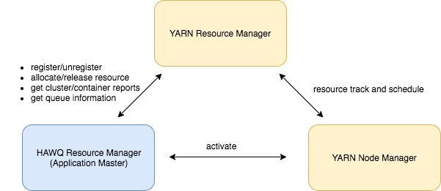
HAWQ Resource Management
Two Modes:
1. Standalone mode:
segments reports its capability(cpu/memory) via heartbeat message to Master.
HAWQ manages available resources by itself.
2. Global resource manager mode(YARN)
HAWQ negotiates resources with YARN Resource Manager.
Two-level Scheduling
Notes:
YARN is a two-level scheduling, the first level, application master request resources from YARN’s Resource manager.The second level, application master allocate there sources to its tasks.
Similarly,HAWQ Resource manager behaves like a application master , it request the resources from YARN and allocate to queries,
after query is finished, HAWQ RM will not immediately release these containers to YARN.
cache the resources for a while, by default 10 minutes, which can be configured, for next coming query, to reduce the latency and communication frequency with YARN.

Slide 10
Bring SQL on Hadoop to Cloud
HAWQ Advantages
Storage computing separation
Elastic query execution engine
Stateless segment
Cloud Requirement
Database as Service
Infrastructure agnostic
Unified and faster database cluster provision
DBA Free

Slide 11
Kubernetes Overview
Container orchestration platform
Abstracts bare metal and most cloud providers
Google, AWS, Azure, VMware
Cloud Native application Operation System
Supported by open source community

Slide 12
Kubernetes Object
Node
Pod
Service
ConfigMap
Persistent Volume
Persistent Volume Claim
Deployment
StatefulSet
DaemonSet

Slide 13
Apache HAWQ on Kubernetes
Components
Master & Standby → Statefulset (Replica:2)
Segments → Deployment (Replica:N)
Database endpoint
Service
Configurations
ConfigMap
Storage
Local Persistent Volume
HDFS
Namenode → Statefulset
Datanode → Daemonset

Slide 14
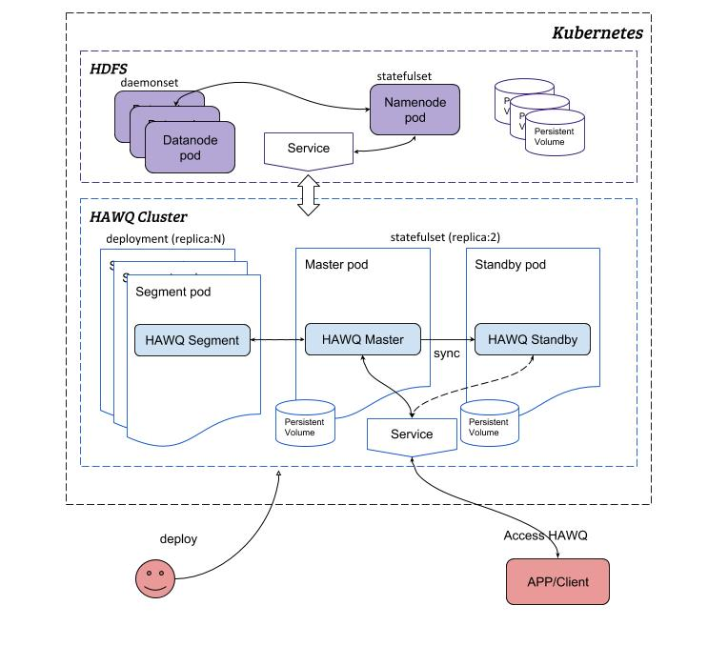
Apache HAWQ on Kubernetes

Slide 15
Pros and Cons
Pros:
Deploy once, run anywhere
Component auto failover
Unified database service endpoint
Cons:
DBA involved
Maintain complicated YAML files
Activate standby
Expansion
……
No control of Master/Standby Pod schedulings
Inefficient management utilities
SSH to container
Cluster start|stop|restart

Slide 16
Kubernetes CRD and Operator
Custom Resource Definition
Extension of Kubernetes API
The same as build-in resource
Operator
Custom controller
Encode domain knowledge for application

Slide 17
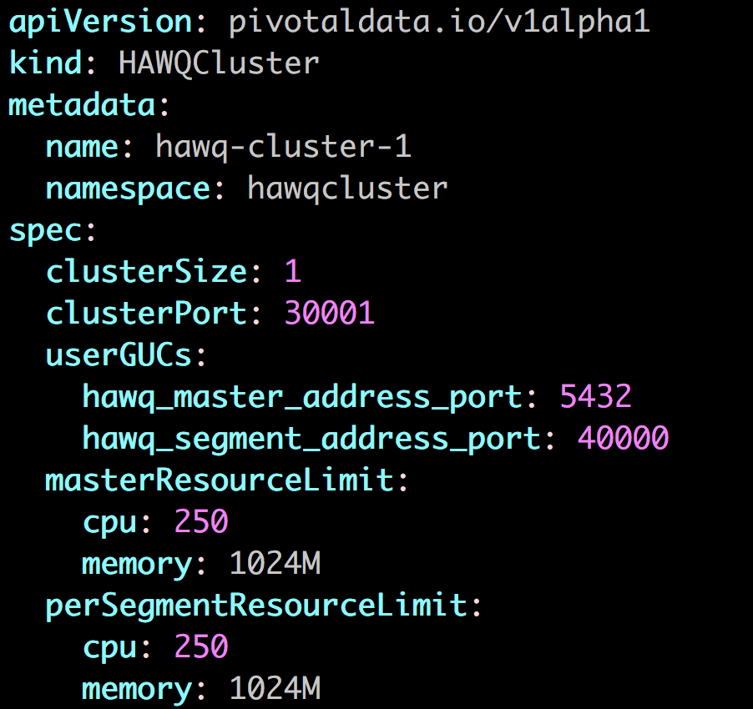
HAWQ CRD and Operator
Operator
Act as DBA
Auto cluster provision
Auto activate standby

Slide 18
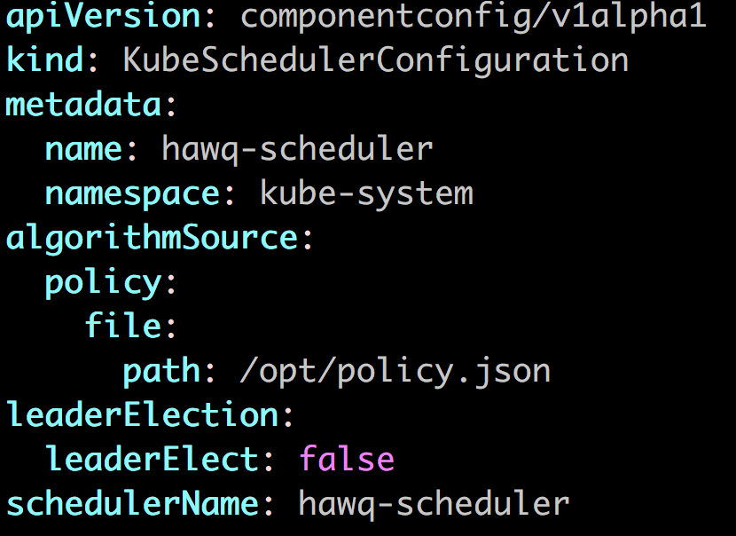
HAWQ Custom Scheduler
Node Affinity/Anti-Affinity
Standalone scheduler server
Scheduler extender

Slide 19
Other Components
HAWQ Config Service
Global configurations
External port
HDFS directory
HAWQ user configurations
User private configurations
HAWQ Proxy
HAWQ process supervisor
HTTP Service
Serve cluster management utilities

Slide 20
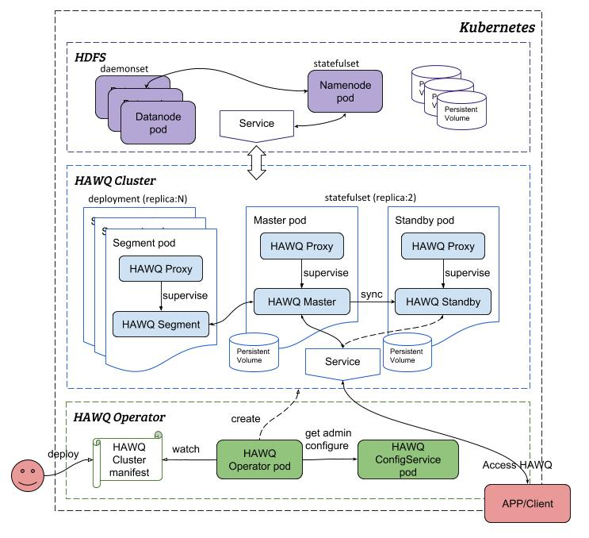
Apache HAWQ on Kubernetes

Slide 21
Lesson Learned
Resource management is important for container applications
Pod Resource Limit Setting
Pod Scheduling
Make component as service
Efficient application management utilities

Slide 22
Thank you! Questions?

