Slide 1

@csantanapr
Apache OpenWhisk
Kubernetes
Carlos santana
STSM, IBM Cloud Functions
Apache OpenWhisk Committer/PPMC

Slide 2
Agenda
Apache OpenWhisk and Kubernetes
1 | What is OpenWhisk?
2 | How do I use it?
3 | How does it work?
4 | How many ways to deploy?
5 | How do I run it on Kubernetes?
6 | Bonus !
Notes:
`

Slide 3

Apache OpenWhisk (Incubating)
Open Source Platform for Serverless/FaaS
Individual Contributors
https://github.com/apache/incubator-openwhisk www.openwhisk.org

Slide 4

OpenWhisk Concepts
Source (events)
Results
Triggers
(response)
Blocking
Actions/WeActions
Actions
(code)
Rules

Slide 5
IBM Cloud Functions
Production Ready Serverless
Large scale (many millions invocations daily)
Hight Availability and scalability
Multi-tenant – isolation & security (arbitrary code & many users)
Cloud Integration (logging, monitoring, auth, service bindings, tools)
Free monthly tier: 400,000GBs
No extra charges (API Gateway, Bandwidth, # requests, logs)

Slide 6
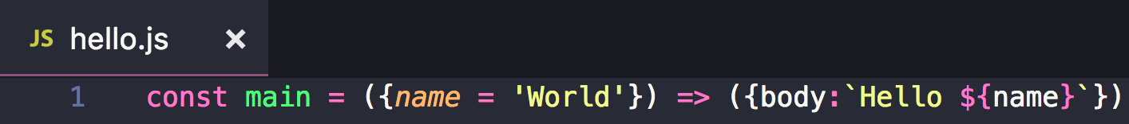
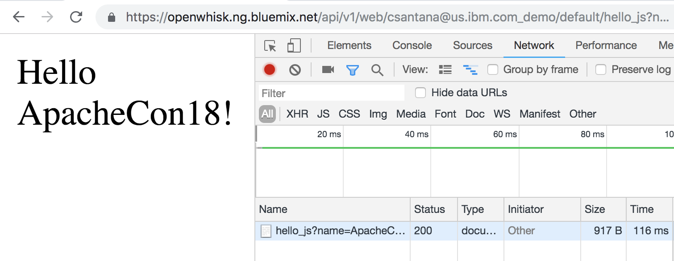
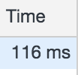
Functions
http://bit.ly/apachecon18

Slide 7

But How?
CouchDB
code
crud
code
/init
request
/run
code
Action
Runtime
Controller
Kafka
Invoker
response
result
logs
records
OpenWhisk

Slide 8

Action Runtimes
Pre-defined Runtime
Extend Runtime with Docker Actions
Any Code with
Docker Actions
Web server
/init
FaaS
Framework
code
FaaS
Framework
code
/run
zip/jar
zip/jar
listen *:8080
JavaScript
Python
Swift
PHP
Ruby
Bash
Perl
Java
Kotlin*
Golang*
Executable (c++, rust, etc..)
libraries, dependencies, common
libraries, dependencies, common

Slide 9

Personas
Application Developer
INFRA Operator

Slide 10
Deploy (Containers)
Hosted Serverless (ie IBM Cloud Functions)
Managed Kubernetes (ie IBM Cloud Kubernetes Service)
Kubernetes on prem
Minikube
Docker-compose
Ansible
Vagrant (Windows)
Mesos

Slide 11
Ansible
git clone https://github.com/apache/incubator-openwhisk
cd incubator-openwhisk/
export OPENWHISK_HOME=$(pwd)
export PATH=“$PATH:/$OPENWHISK_HOME/bin”
wskdev fresh
controller
invoker
invoker
invoker
couchdb
system setup
ansible-playbook -i environments/local setup.yml
deploy couchdb
ansible-playbook -i environments/local couchdb.yml
initialize db with guest/system keys
ansible-playbook -i environments/local initdb.yml
recreate main db for entities
ansible-playbook -i environments/local wipe.yml
build/deploy system
./gradlew distDocker --parallel
ansible-playbook -i environments/local openwhisk.yml
install catalog
ansible-playbook -i environments/local postdeploy.yml
nginx
apigateway
kafka
zookeeper
redis

Slide 12

Easy to deploy with Helm
$ git clone
$ helm install
Native integrations
Kubernetes Container Factory
Kubernetes Agent
Helm Charts
HA configs
Akka bootstrapping
Logging
Monitoring
Event Source Providers/Brokers
Containerd*
Isolation & Security
https://github.com/apache/incubator-openwhisk-deploy-kube

Slide 13
Kubernetes
SaaS
couchdb
apigateway
Controllers as stateful sets
Invokers as deamon sets
Affinity via node labes
Config via ConfigMaps
Secrets via SecretMaps
kafka
redis
zookeeper
controller-0
pod
node
invoker-*
invoker-*
invoker-*
invoker-*
invoker-n
pod
pod
pod
pod
pod
controller-n
node
node
node
node
node
pod
node
Repository: https://github.com/apache/incubator-openwhisk-deploy-kube

Slide 14
Helm
The package manager for Kubernetes
Deployment easy, standardized and reusable
Operator productivity
Reduce deployment complexity
Speeds up adoption of cloud native
Avoids duplication
Helm CLI
Tiller

Slide 15
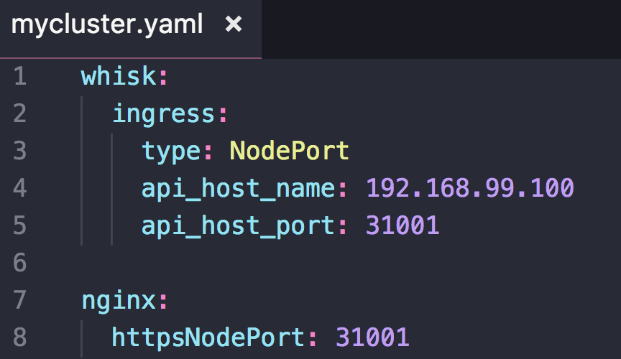
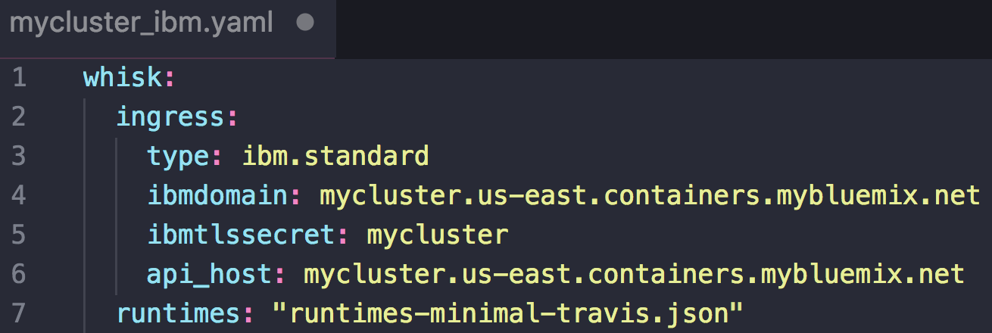
minikube
1. Repository: https://github.com/apache/incubator-openwhisk-deploy-kube
2. Kubectl and Minikube
asdf install kubectl 1.10.5 && asdf global kubectl 1.10.5
asdf install minikube 0.28.2 && asdf global minikube 0.28.2
minikube start
3. Helm
helm init
kubectl create clusterrolebinding tiller-cluster-admin …
4. Namespace and Labels
kubectl create namespace openwhisk
kubectl label nodes --all openwhisk-role=invoker
5. Deploy OpenWhisk
helm install ./helm/openwhisk -f mycluster.yaml …
6. Configure OpenWhisk CLI
wsk property set --apihost 192.168.99.100:31001
wsk property set --auth 23bc46b1-71f6-4ed5-8c54-816aa4f8c502:

Slide 16
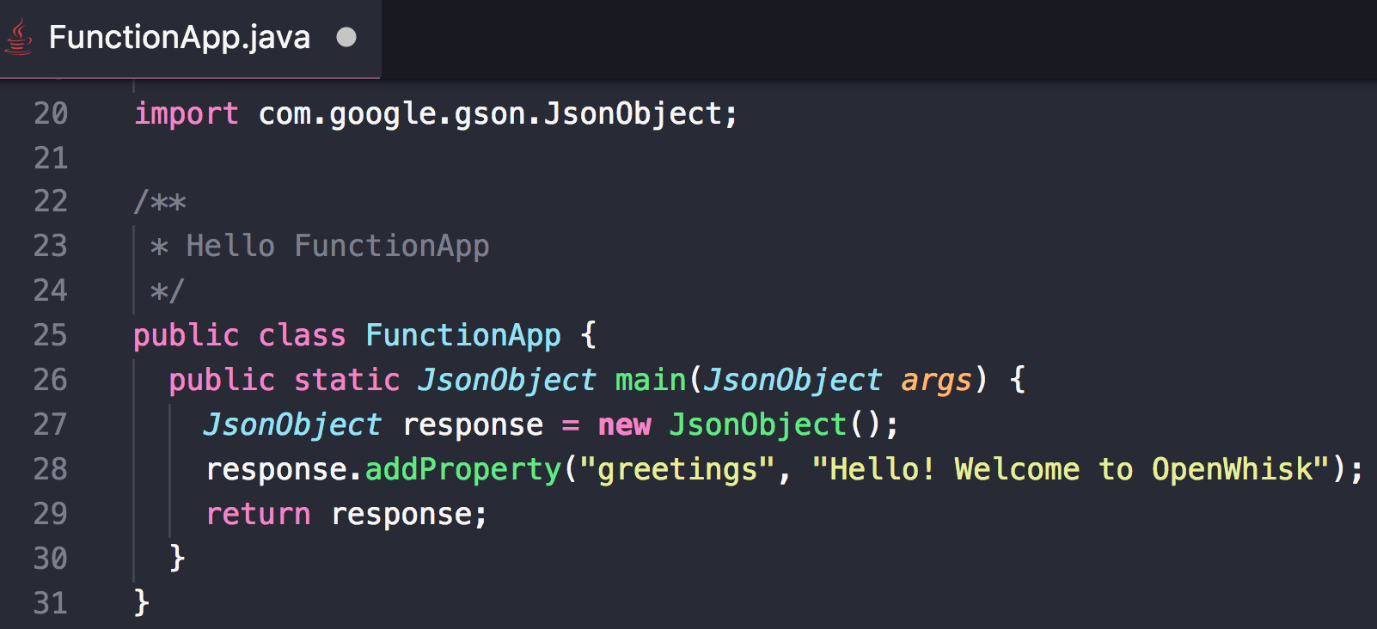
Demo: Java Serverless
Setup Kubernetes Cluster
Deploy OpenWhisk using Helm
Configure wsk CLI
Scaffold project using archetype
Build Action jar with mvn install
Deploy jar using wsk CLI
https://github.com/apache/incubator-openwhisk-devtools

Slide 17
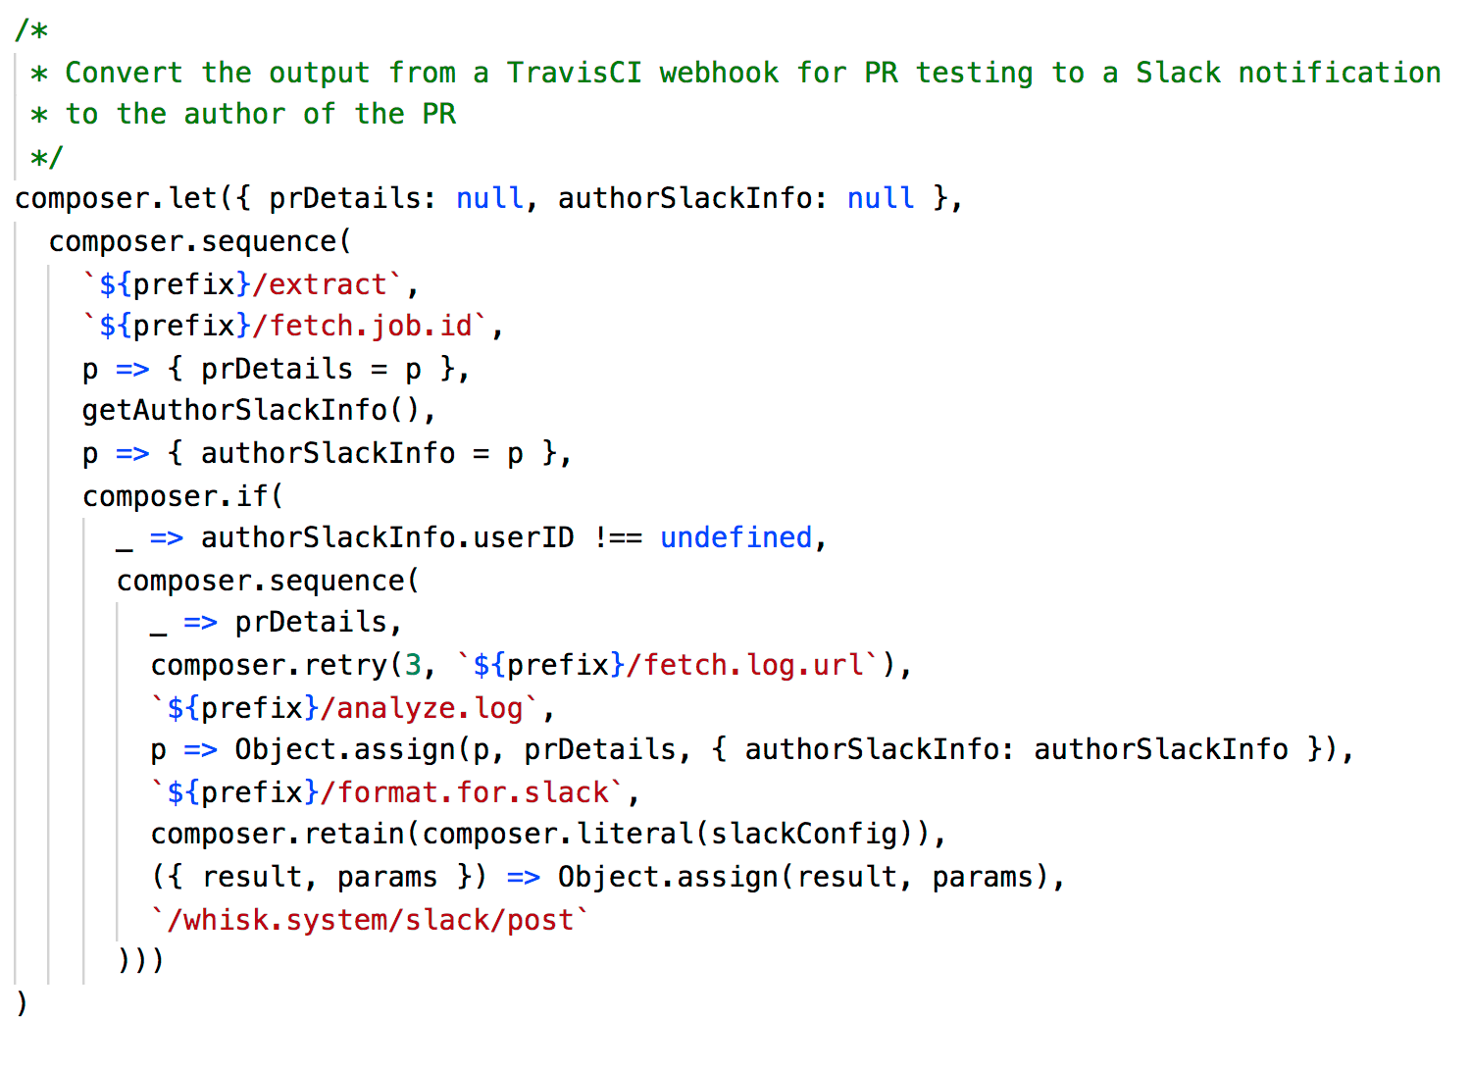
Bonus (Compositions)

Slide 19
Links !!
IBM Cloud
ibmcloud.com
OpenWhisk
openwhisk.com
github.com/apache/incubator-openwhisk
slack.openwhisk.com.com
Kube Repo
github.com/apache/incubator-openwhisk-deploy-kube
Docker-Compose
github.com/apache/incubator-openwhisk-devtools
Mesos
github.com/apache/incubator-openwhisk-deploy-mesos
IBM Functions Shell & Composer
github.com/ibm-functions/shell
Demo code from this slides
github.com/csantanapr/dockercon

Slide 20
Backup slides

Slide 21
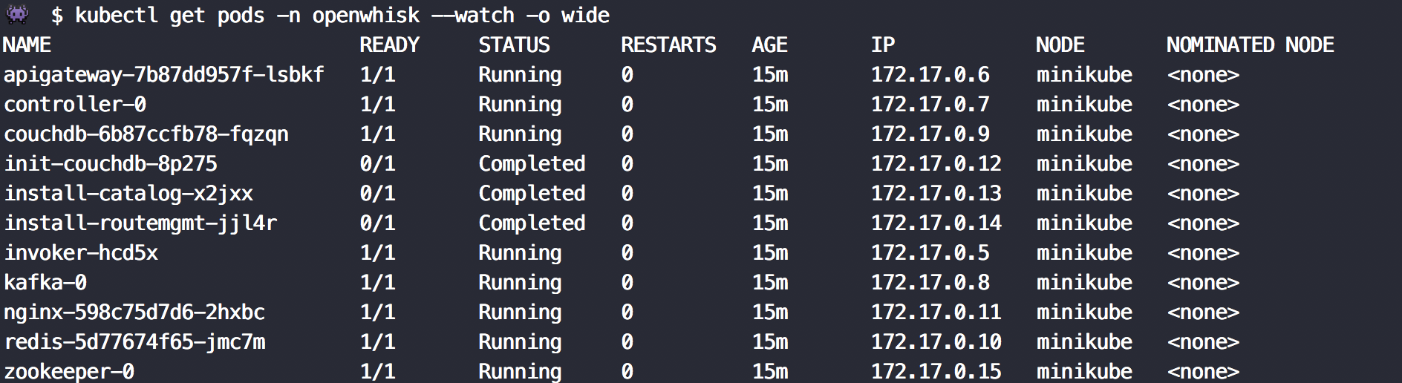

Slide 22
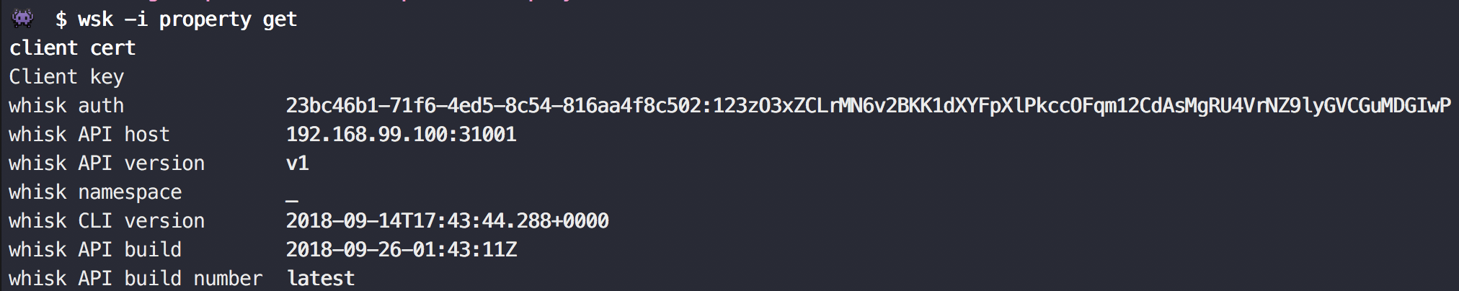

Slide 24
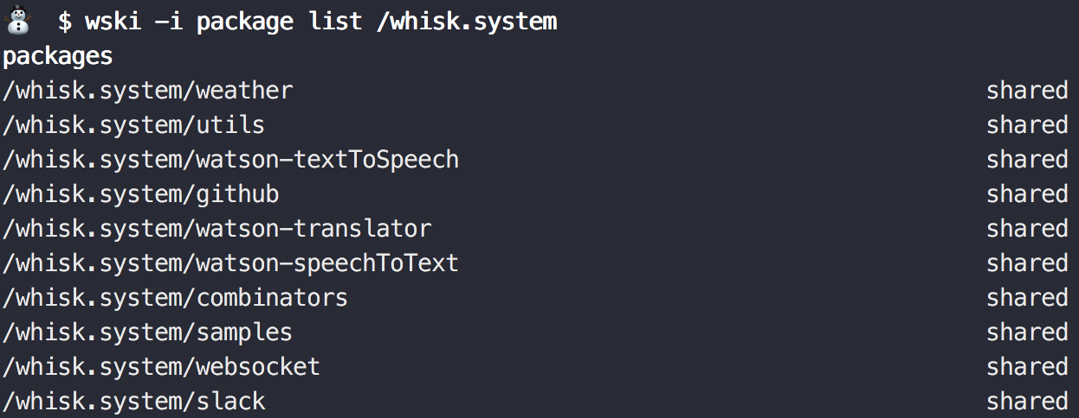

Slide 25
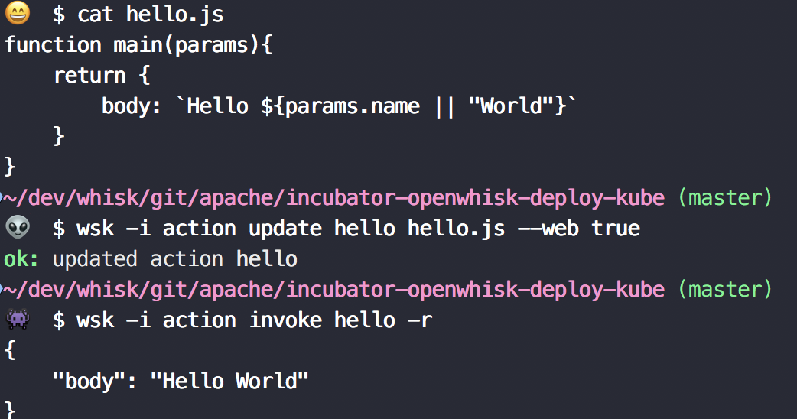

Slide 26
