Slide 1
Under-the-hood: Creating Your Own Spark Data Sources
Speaker: Jayesh Thakrar @ Conversant

Slide 2
Why Build Your Own Data Source?
Don't need
text, csv, ORC, Parquet, JSON files
JDBC sources
When available from project / vendor, e.g.
Cassandra, Kafka, MongoDB, etc
Teradata, Greenplum (2018), etc
Need to
Use special features, e.g.
Kafka transactions
Exploit RDBMS specific partition features
Because you can, and want to ☺
Conversant Use Cases (mid-2017)
Greenplum as data source (read/write)
Incompatibility between Spark, Kafka and Kafka connector versions

Slide 3
Agenda
Introduction to Spark data sources
Walk-through sample code
Practical considerations

Slide 4
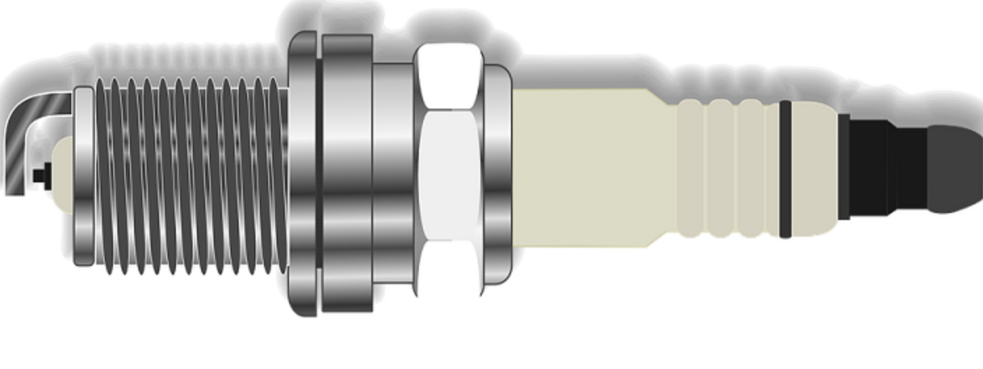
Introduction To Spark Data Source

Slide 5
Using Data Sources
Built-in
spark.read.csv("path")
spark.read.orc("path")
spark.read.parquet("path")
Third-party/custom
spark.read.format("class-name").load() // custom data source spark.read.format("...").option("...", "...").load() // with options
spark.read.format("...").schema("..").load() // with schema

Slide 6
Spark Data Source
Spark Application
Spark API
Spark Backend (runtime, Spark libraries, etc)
Data
Spark Data Source

Slide 7
Data Source V2 API
Shiny, New V2 API
since Spark 2.3 (Feb 2018)
SPARK-15689
No relations, scans involved
Spark Application
Spark API
Spark Backend (runtime, Spark libraries, etc)
Data
Spark Data Source

Slide 8
V2 API: Data Source Types
Data Source Type | Output
Batch | Dataset
Microbatch (successor to Dstreams) | Structured Stream = stream of bounded dataset
Continuous | Continuous Stream = continuous stream of Row(s)

Slide 9
V2 DATA SOURCE API
Well documented design
V2 API : Design Doc , Feature SPARK-15689 Continuous Streaming Design Doc and Feature - SPARK-20928
Implemented as Java Interfaces (not classes)
Similar interfaces across all data source types
Microbatch and Continuous not hardened yet...
e.g. SPARK-23886, SPARK-23887, SPARK-22911

Slide 10
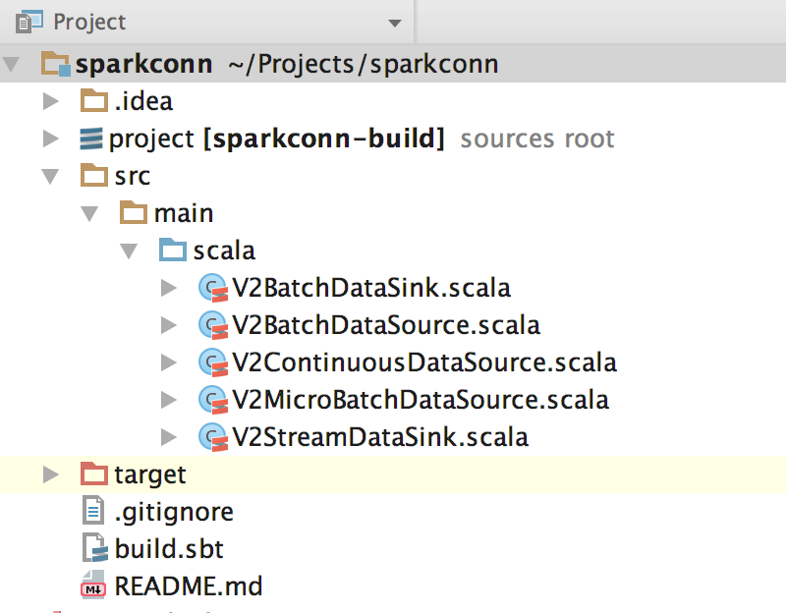
Code Walkthrough

Slide 11
Details
Project: https://github.com/JThakrar/sparkconn
Requirements:
Scala 2.11
SBT

Slide 12
Reading From Data Source
val data = spark.read.format("DataSource").option("key", "value").schema("..").load()
Step | Action
spark | = SparkSession
read | Returns a DataFrameReader for data source orchestration
format | Lazy lookup of data source class - by shortname or by full-qualified class name
option | Zero, one or more key-value pairs of options for data source
schema | Optional, user-provided schema
load | Loads the data as a dataframe. Remember dataframes are lazily-evaluated.

Slide 13
Reading: Interfaces to Implement
Driver
DataSourceRegister
ReadSupport ReadSupportWithSchema
Executors / Tasks / Partitions
spark.format(...)
DataReaderFactory
DataReader
DataSourceReader
DataReaderFactory
DataReader
Need to implement a minimum of 5 interfaces and 3 classes
DataReaderFactory
DataReader

Slide 14
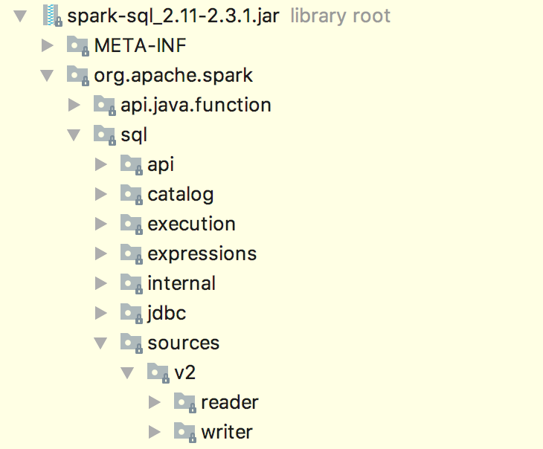
Interface Definitions And Dependency
libraryDependencies += "org.apache.spark" %% "spark-sql" % "2.3.1" % "provided"

Slide 15
Example V2 API Based Datasource
Very simple data source that generates a row with a fixed schema of a single string column. Column name = "string_value"
Completely self-contained (i.e. no external connection)
Number of partitions in dataset is user-configurable (default = 5)
All partitions contains same number of rows (strings)
Number of rows per partition is user-configurable (default = 5)

Slide 16
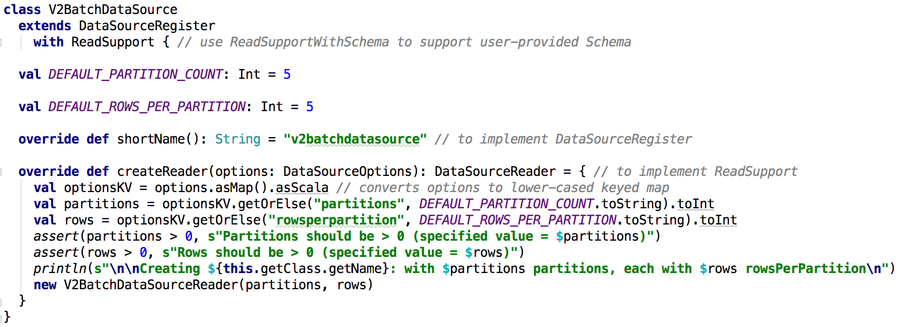
Read Interface: DataSourceRegister
Interface | Purpose
org.apache.spark.sql.sources.v2.DataSourceRegister org.apache.spark.sql.sources.v2.ReadSupport and / or org.apache.spark.sql.sources.v2.ReadSupportWithSchema | DataSourceRegister is the entry point for your data source. ReadSupport is then responsible to instantiate the object implementing DataSourceReader (discussed later). It accepts the options/parameters and optional schema from Spark application.

Slide 17
Read Interface: DataSourceReader
Interface | Purpose
org.apache.spark.sql.sources.v2.reader.DataSourceReader | This interface requires implementations for: determining the schema of data determining the number of partitions and creating that many reader factories below.

Slide 18
Read Interface: DataReaderFactory
Interface | Purpose
org.apache.spark.sql.sources.v2.reader.DataReaderFactory | This is the "handle" passed by the driver to each executor. It instantiates the readers below and controls data fetch.

Slide 19
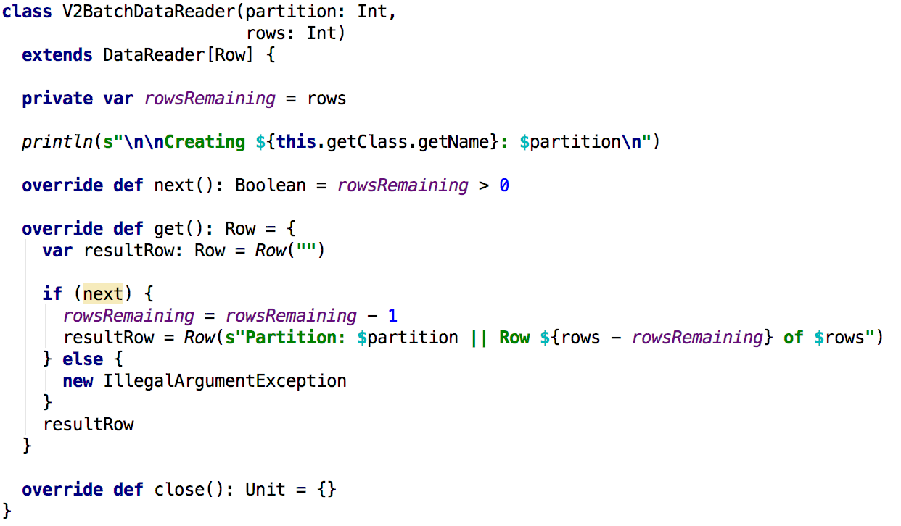
Read Interface: DataReader
Interface | Purpose
org.apache.spark.sql.sources.v2.reader.DataReader | This does the actual work of fetching data from source (at task-level)

Slide 20
Summary
Because you are implementing interfaces, YOU can determine the "class" parameters and initialization
Interface | Purpose
org.apache.spark.sql.sources.v2.DataSourceRegister org.apache.spark.sql.sources.v2.ReadSupport org.apache.spark.sql.sources.v2.ReadSupportWithSchema | DataSourceRegister is the entry point for your connector. ReadSupport is then responsible to instantiate the object implementing DataSourceReader below. It accepts the options/parameters and optional schema from Spark application.
org.apache.spark.sql.sources.v2.reader.DataSourceReader | This interface requires implementations for: determining the schema of data determining the number of partitions and creating that many reader factories below. The DataSourceRegister, DataSourceReader and DataReaderFactory are instantiated at the driver. The driver then serializes DataReaderFactory and sends it to each of the executors.
org.apache.spark.sql.sources.v2.reader.DataReaderFactory | This is the "handle" passed by the driver to each executor. It instantiates the readers below and controls data fetch.
org.apache.spark.sql.sources.v2.reader.DataReader | This does the actual work of fetching data

Slide 21
Write Interfaces to Implement
Interface | Purpose
org.apache.spark.sql.sources.v2.DataSourceRegister org.apache.spark.sql.sources.v2.WriteSupport | DataSourceRegister is the entry point for your connector. WriteSupport is then responsible to instantiate the object implementing DataSourceWriter below. It accepts the options/parameters and the schema.
org.apache.spark.sql.sources.v2.writer.DataSourceWriter | This interface requires implementations for: committing data write aborting data write creating writer factories The DataSourceRegister, DataSourceWriter and DataWriterFactory are instantiated at the driver. The driver then serializes DataWriterFactory and sends it to each of the executors.
org.apache.spark.sql.sources.v2.writer.DataWriterFactory | This is the "handle" passed by the driver to each executor. It instantiates the writers below and controls data fetch.
org.apache.spark.sql.sources.v2.writer.DataWriter | This does the actual work of writing and committing/aborting the data
org.apache.spark.sql.sources.v2.writer.WriterCommitMessage | This is a "commit" message that is passed from the DataWriter to DataSourceWriter.

Slide 22
Practical Considerations

Slide 23
Know Your Data Source
Configuration
Partitions
Data schema
Parallelism approach
Batch and/or streaming
Restart / recovery

Slide 24
V2 API IS STILL EVOLVING
SPARK-22386 - Data Source V2 Improvements
SPARK-23507 - Migrate existing data sources
SPARK-24073 - DataReaderFactory Renamed in 2.4
SPARK-24252, SPARK-25006 - DataSourceV2: Add catalog support
So Why use V2? Future-ready and alternative to V2 needs significantly more time and effort! See https://www.youtube.com/watch?v=O9kpduk5D48

Slide 25
About...
Conversant
Digital marketing unit of Epsilon under Alliance Data Systems (ADS)
(Significant) player in internet advertising. We see about 80% of internet ad bids in the US
Secret sauce = anonymous cross-device profiles driving personalized messaging
Me (Jayesh Thakrar)
Sr. Software Engineer (jthakrar@conversantmedia.com)
https://www.linkedin.com/in/jayeshthakrar/

Slide 26
Questions?

