Slide 1
CloudStack with Ansible Automation
André Walter & Ingo Jochim
25th September 2018

Slide 2
Agenda
Talk André
Talk Ingo

Slide 3
About André
Head of itelligence GMS Cloud Infrastructure Services
@meradioc
https://www.linkedin.com/in/andre-walter-87215a35/

Slide 4
Agenda - André
About itelligence and our focus
Typical use case (SAP HANA)
Resulting requirements
Why Apache CloudStack

Slide 5
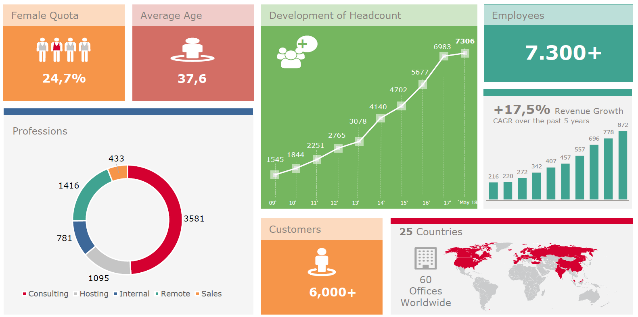
itelligence Worldwide - Numbers

Slide 6
itelligence Managed Services – Service Centers Worldwide
Oslo(NO)
Bielefeld (DE)
Horsens (DK)
Eindhoven (NL)
Poznan (PL)
Montreal (CA)
Glasgow (UK)
Moskow (RU)
Paris (FR)
Bautzen/ Dresden (DE)
Zurich (CH)
Budapest (HU)
Praha (CZ)
Cincinnati (US)
Barcelona (ES)
Istanbul (TR)
Shanghai (CN)
Hyderabad (IN)
Kuala Lumpur (MY)
Our Data Centers world-wide…
Bielefeld
Kuala Lumpur
Bautzen
Poznan
Cincinnati

Slide 7
GMS Cloud Strategy | Change of Customer Application Landscape
„We manage your (SAP) Cloud!“
As many customers are planning to use public or hybrid cloud services, combination of cloud services is key for success
Use of cloud infrastructure capabilities of NTT Group
itelligence partnership with as the leading Hyperscaler
High quality Technical and Application Management Services are foundation for smart Cloud Management

Slide 8
Use Case - SAP Hana
The SAP HANA database is a hybrid, relational in-memory database that combines row-based, column-based, and object-based database technologies and has been optimized for the use of parallel processing functionality of modern multi-core and CPU architectures.
This architecture enables SAP applications to benefit from current hardware technologies.
The SAP HANA database is a central component of SAP products that help customers make their processes more efficient, flexible, and profitable.

Slide 9
Resulting Requirements
Often physical servers.
No containers.
All data are in memory.
Machines with lot’s of RAM.
Huge workloads.
Complex backup and disaster recovery scenarios.

Slide 10
Resulting Requirements - Private Cloud
Complete control over tools and technology.
Full data control.
SLAs important.
Special use cases.

Slide 11
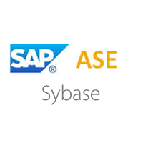
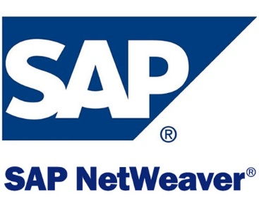
What we do with our cloud?
Mostly running SAP systems / IaaS.
Production / Training / Demo / Development.

Slide 12
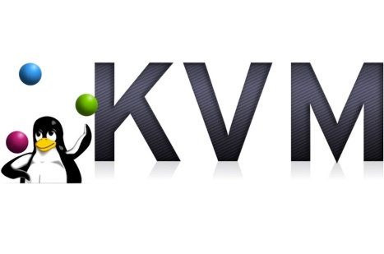
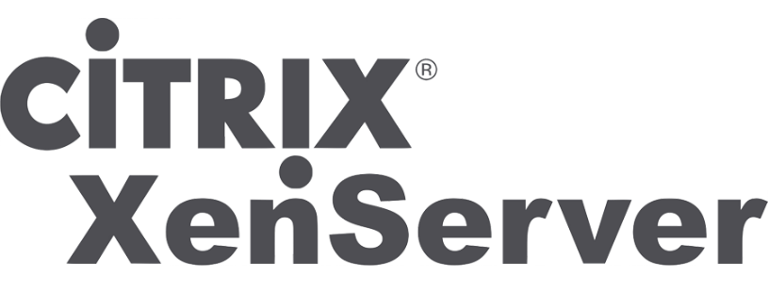
Why Apache CloudStack?
Our requirements:
Multi tenancy.
OpenSource.
Powerful API.
Easy to use.
Frequent updates.
Good community.
Multi hypervisor support.

Slide 13
#cloudstackworks – Our Experience, What We Like?
Made good experience because #cloudstackworks.
Easy to upgrade.
Stable, simple, easy to maintain.
Great community.
Free, OpenSource.
We

Slide 14
Questions?

Slide 15
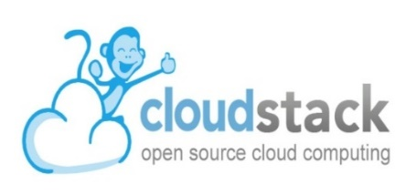
About Ingo
Head of CIS - Cloud Implementation
@ingojochim
https://www.linkedin.com/in/ingo-jochim-b30b8590/
CloudStack user since 2014

Slide 16
Agenda - Ingo
Big picture of our cloud.
CloudStack THE central component.
Customer portal.
Portal - How it works?
Ansible daemon.
Response in user interface.
Dynamical user interface.
Automation host - network setup.
Scalable setup.
Application installation automation.

Slide 17
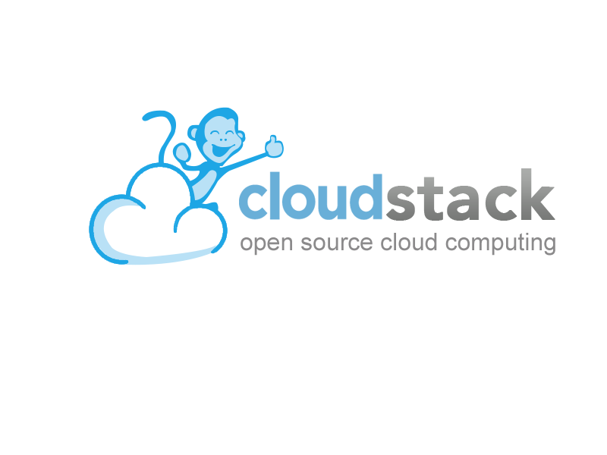
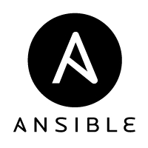
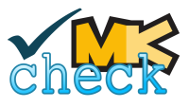
Big Picture of Our Cloud

Slide 18
Talk Reference
CloudStack + Ceph (Sebastian Bretschneider - Monday, 24th Sep, 15:40)
Abstract:
This is about our way from NFS to CEPH as primary Storage in CloudStack. Disadvantages about NFS as primary Storage - recommendations for CEPH - what can go wrong. Stories of a Sysadmin.
https://apachecon.dukecon.org/acna/2018/#/scheduledEvent/d3b061c4a120801e8
Billing with CloudStack (Alexander Stock - Monday, 24th Sep, 16:40)
Abstract:
In this talk you will see which tools we use to generate billing reports for cloudstack and what were the difficulties which we discovered during the implementation.
https://apachecon.dukecon.org/acna/2018/#/scheduledEvent/dcf32b078a6d4f21d

Slide 19
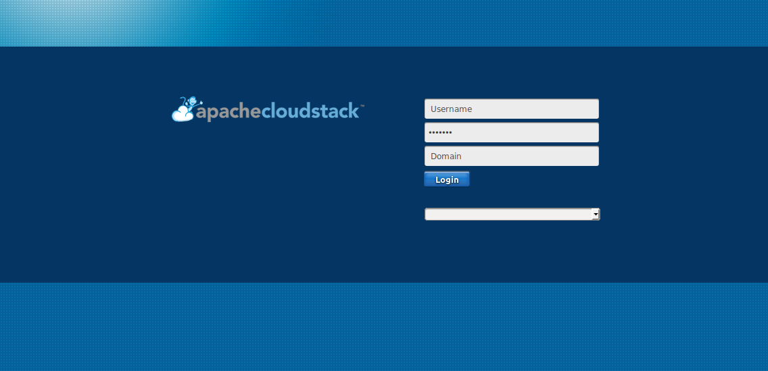
CloudStack The central component
Used via API.
We use it for:
Compute.
Block storage.
Network.
Usage recording.
Tagging.

Slide 20
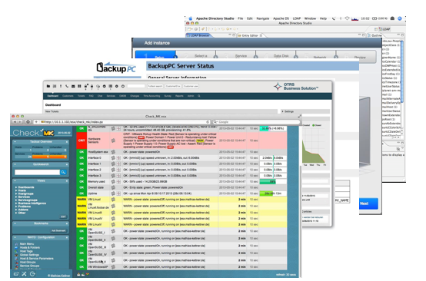
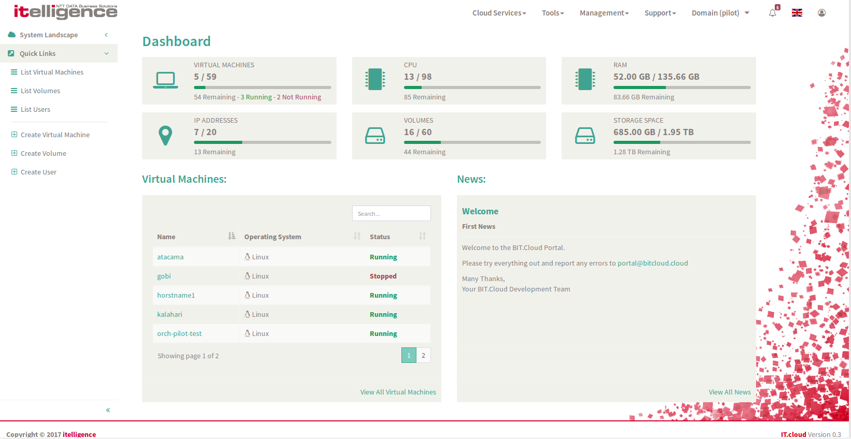
Customer Portal
Consolidate the varying systems with their individual design and functions.
Facilitate process automation.

Slide 21
Portal - How it works?
read operations - synchron
write operations - asynchron
...

Slide 22
Ansible Daemon
Queue
Self written application.
Functionality:
Queueing jobs.
Parallel execution.
Status response of jobs.
Reading automation playbooks (header information).
Parallel execution
Playbook header

Slide 23
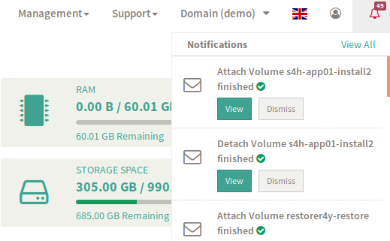
Response in User Interface – Asynchron Jobs

Slide 24
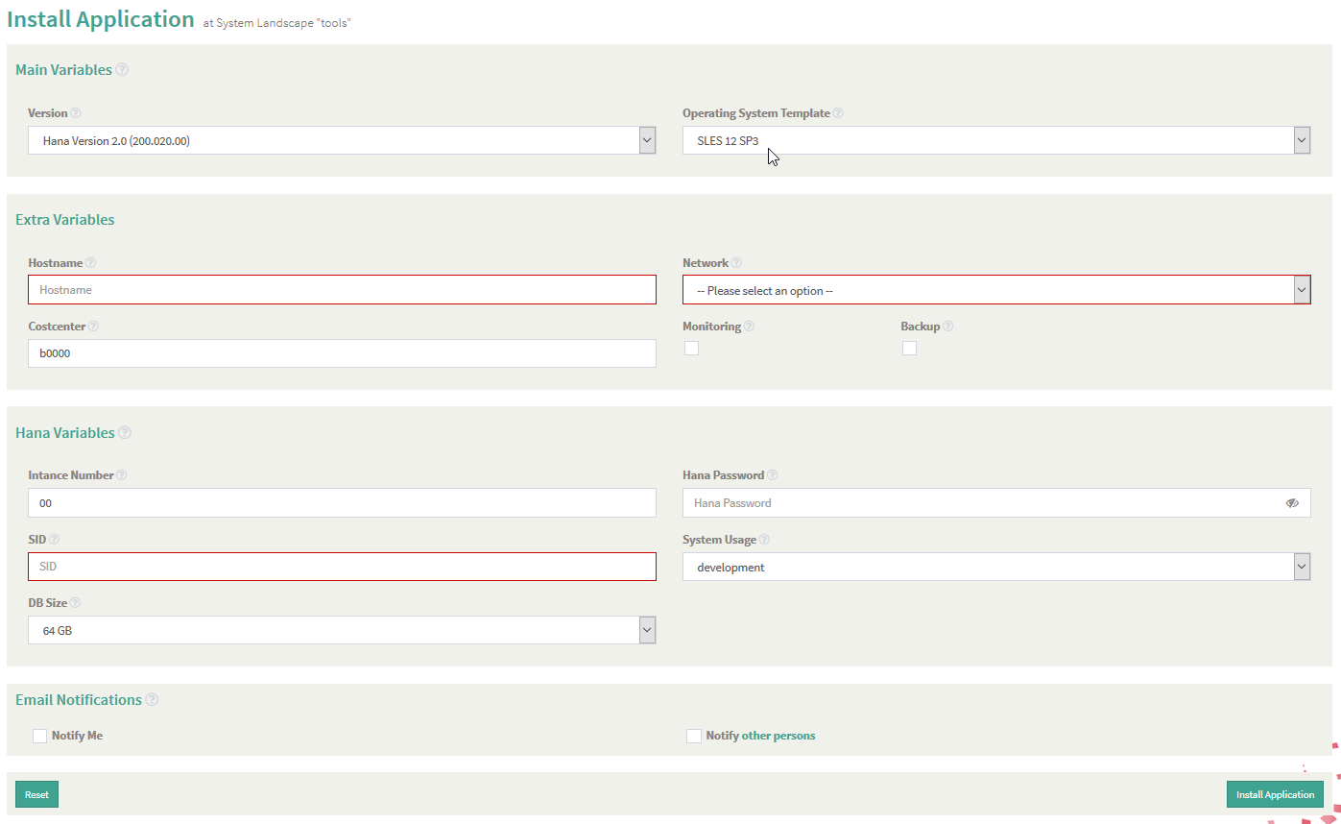
Dynamical User Interface by Playbooks
Defined in playbook header
Category
Available playbooks
Required values
Dependencies

Slide 25
Automation Host and Network Setup
Automation host
Customer network
Customer machines

Slide 26
Scalable Setup
portal, LDAP, monitoring
scalelable: ansible, LDAP, monitoring

Slide 27
Application Installation Automation
Complete automation in a single step
Compute
Storage
Application
Firewall
Monitoring
Backup

Slide 28
Questions?

Slide 29
Copyright itelligence AG - All rights reserved
No part of this publication may be reproduced or transmitted in any form or for any purpose without the express permission of itelligence AG. The information contained herein may be changed without prior notice.
Some software products marketed by itelligence AG and its distributors contain proprietary software components of other software vendors. All product and service names mentioned and associated logos displayed are the trademarks of their respective companies. Data contained in this document serves informational purposes only. National product specifications may vary.
The information in this document is proprietary to itelligence. This document is a preliminary version and not subject to your license agreement or any other agreement with itelligence. This document contains only intended strategies, developments and product functionalities and is not intended to be binding upon itelligence to any particular course of business, product strategy, and/or development. itelligence assumes no responsibility for errors or omissions in this document. itelligence does not warrant the accuracy or completeness of the information, text, graphics, links, or other items contained within this material. This document is provided without a warranty of any kind, either express or implied, including but not limited to the implied warranties of merchantability, fitness for a particular purpose, or non-infringement.
itelligence shall have no liability for damages of any kind including without limitation direct, special, indirect, or consequential damages that may result from the use of these materials. This limitation shall not apply in cases of intent or gross negligence.
The statutory liability for personal injury and defective products is not affected. itelligence has no control over the information that you may access through the use of hot links contained in these materials and does not endorse your use of third-party Web pages nor provide any warranty whatsoever relating to third-party Web pages.

