Slide 1
Welcome To ApacheCon North America 2018
The Apache Software Foundation @apachecon
live stream of keynotes at apachecon.com/acna18/stream/

Slide 2
Save the date!
Join us in September, 2019, as we celebrate the 20th Anniversary of the Apache Software Foundation
Follow @ApacheCon to be the first to know!

Slide 3
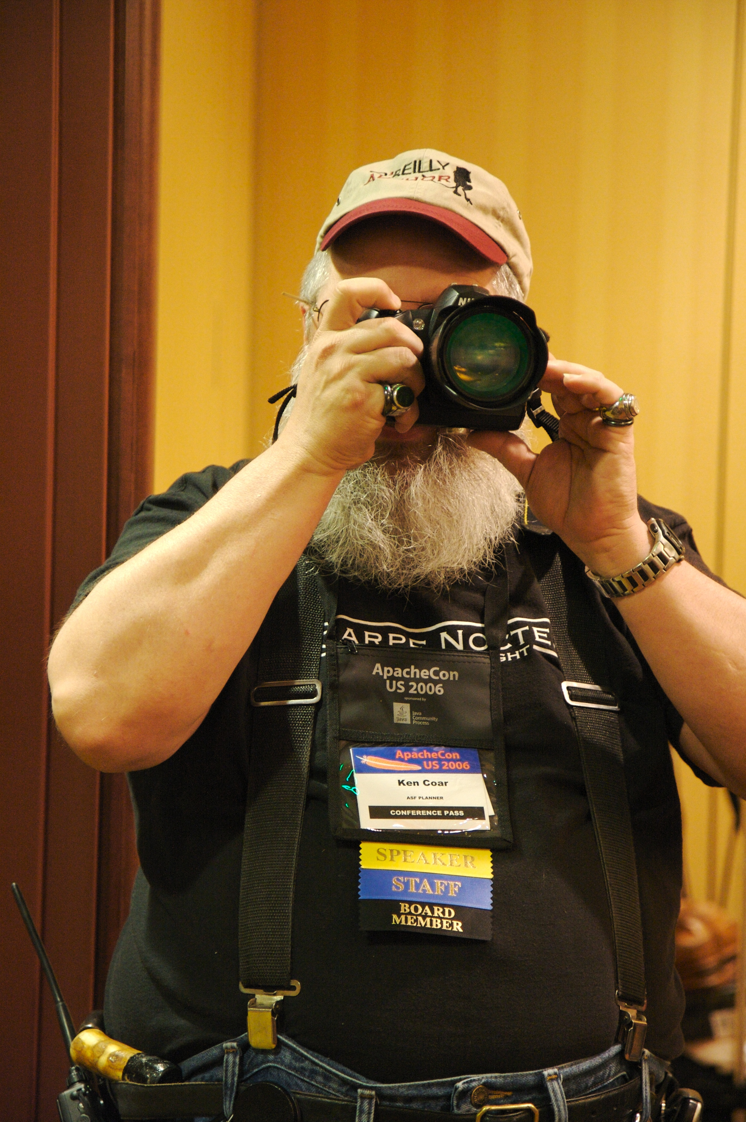
Social Media
Use #apachecon and #acna18
Post photos to Flickr with a CC license
Follow us on Twitter:
@apachecon
CC, Ted Leung, Flickr

Slide 4
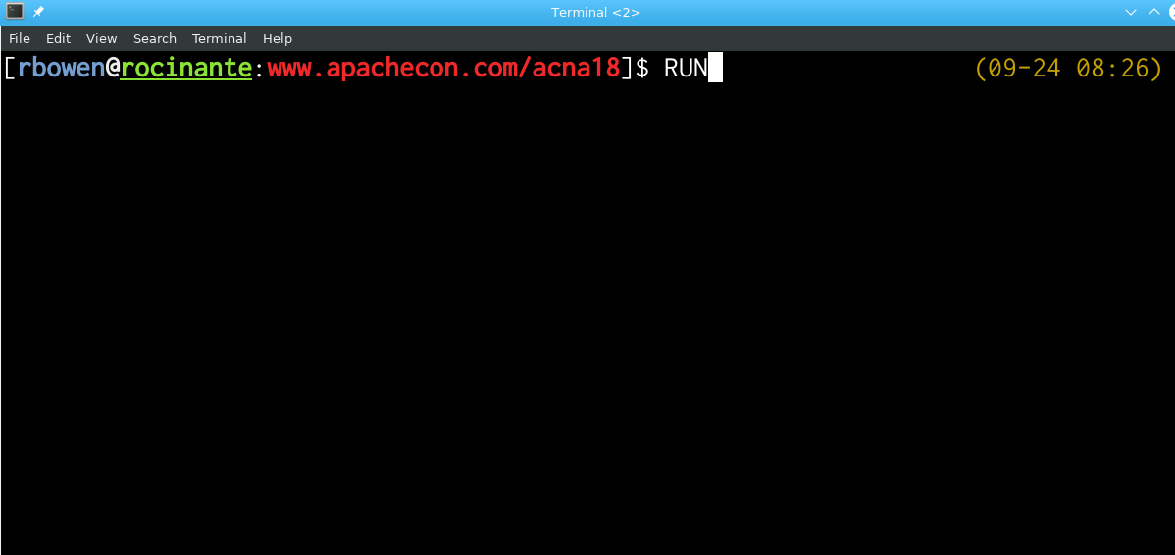
Run
7am, each morning in the lobby, with Jean-Frederic Clere

Slide 5
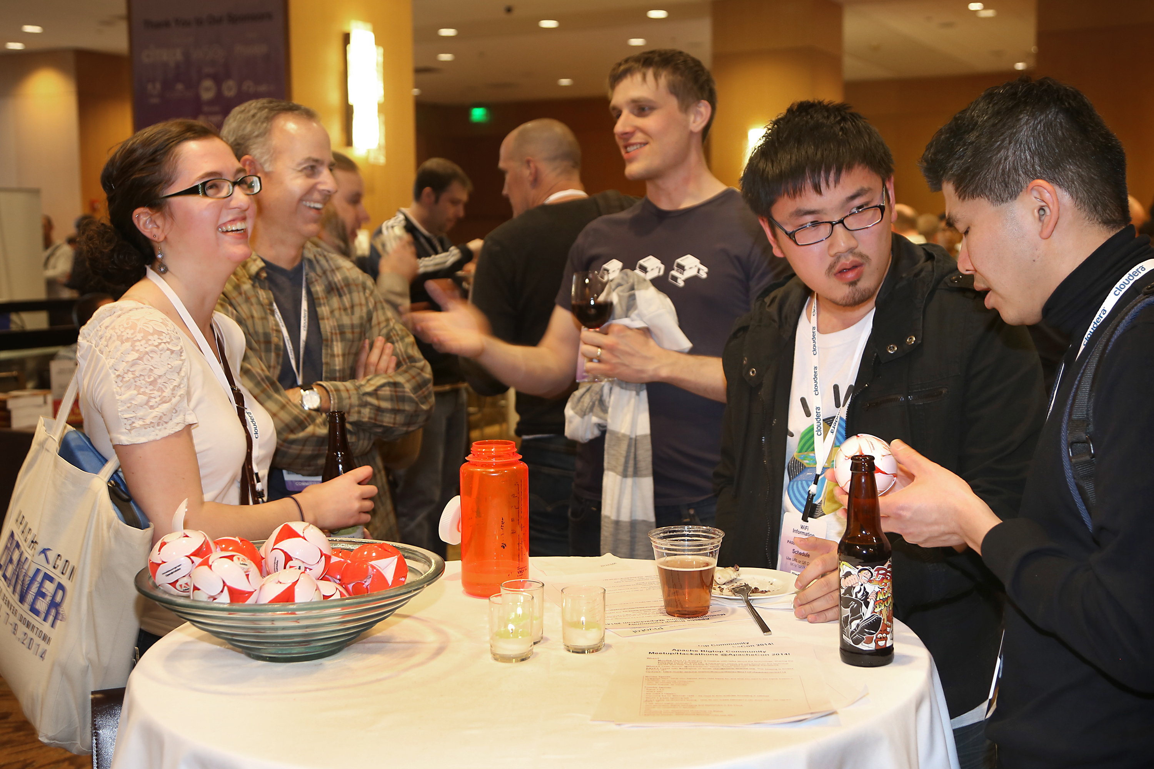
Party!
Tonight: 18:00, Lightning Talks, sponsored by Google Cloud. See Ruth and Daniel to sign up
Every night, BOFs
apachecon.com/acna18/bof.html

Slide 6
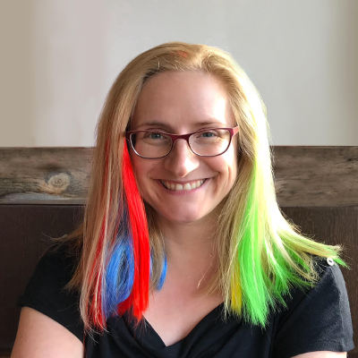
Bridget Kromhout - Containers will not fix your broken culture (and other hard truths)
Principal Cloud Developer Advocate at Microsoft.

Slide 7
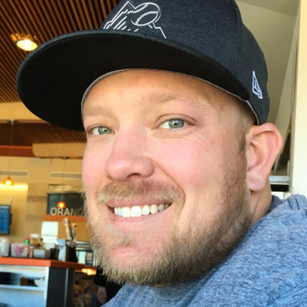
Dave Neuman - Streaming Media at Scale – The Story of How Apache Traffic Control Came To Be
Engineering Leader on the CDN team at Comcast and the PMC chair of Apache Traffic Control

Slide 8
Fred Reiss - From Adam to Zara - Enabling the AI lifecycle for your Enterprise using Open Source
Chief Architect at IBM's Center for Open-Source Data and AI Technologies in San Francisco

Slide 9
Thank you!
Lunch today is on your own
If you didn’t get a tshirt yet, please stop by the registration desk this afternoon
Our event tote bags should be at the reg desk today or at the Lightning Talks. Come get one.

Slide 10
THANK YOU FOR COMING!
Sessions start in 30 minutes
Schedule is at apachecon.com/acna18/schedule

