Slide 1
Data Availability and Integrity in Apache Hadoop
Steve Loughran @steveloughran
Sanjay Radia @srr

Slide 2
Questions Hadoop users ask
Can Hadoop keep my data safe?
Can Hadoop keep my data available?
What happens when things go wrong?
What about applications that use Hadoop?
What's next?
Notes:
Once you adopt Hadoop, it can rapidly become the biggest central storage point of data in an organisation. At which point you start caring about how well it looks after your data.
this talk aims to answer these questions

Slide 3
Hadoop HDFS: replication is the key
Switch
ToR Switch
ToR Switch
ToR Switch
file block1 block2 block3
…
Name Node
DataNode
DataNode
DataNode
DataNode
2ary Name Node
DataNode
DataNode
(Job Tracker)
DataNode
DataNode
Notes:
HDFS is built on the concept that in a large cluster, disk failure is inevitable. The system is designed to change the impact of this from the beeping of pagers to a background hum.
Akey part of the HDFS design: copying the blocks across machines means that the loss of a disk, server or even entire rack keeps the data available.

Slide 4
Replication handles data integrity
CRC32 checksum per 512 bytes
Verified across datanodes on write
Verified on all reads
Background verification of all blocks (~weekly)
Corrupt blocks re-replicated
All replicas corrupt ➔ operations team intervention
2009: Yahoo! lost 19 out of 329M blocks on 20K servers –bugs now fixed
Notes:
There's lots of checksumming going on of the data to pick up corruption -CRCs created at write time (and even verified end-to-end in a cross-machine write), scanned on read time.

Slide 5
Rack/Switch failure
Switch
ToR Switch
ToR Switch
ToR Switch
file block1 block2 block3
…
Name Node
DataNode
DataNode
DataNode
DataNode
2ary Name Node
DataNode
DataNode
(Job Tracker)
DataNode
DataNode
Notes:
Rack failures can generate a lot of replication traffic, as every block that was stored in the rack needs to be replicated at least once. The replication still has to follow the constraints of no more than one block copy per server.
Much of this traffic is intra-rack, but every block which already has 2x replicas on a single rack will be replicated to another rack if possible.
This is what scares ops team.
Important: there is no specific notion of "mass failure" or "network partition". Here HDFS only sees that four machines have gone down.

Slide 6
Reducing the impact of a Rack Failure
Is this a real threat?
Google: failures are rack-correlated
Microsoft: ToR switches fail the most
Facebook: router mis-configuration ➔ cascade failure
Reduce the impact
Dual bonded Ethernet with 2x Top of Rack Switch
10 GbE for more replication bandwidth
Bigger clusters
Facebook: sub-cluster block placement

Slide 7
NameNode failure rare but visible
ToR Switch
1. Try to reboot/restart
Name Node
NN IP
2. Bring up new NameNode server -with same IP -or restart DataNodes
Shared storage for filesystem image and journal ("edit log")
Name Node
NN IP
2ary Name Node
(Secondary NN receives streamed journal and checkpoints filesystem image)
Yahoo!: 22 NameNode failures on 25 clusters in 18 months = .99999 availability
Notes:
When the NameNode fails, the cluster is offline.
client applications -including the MapReduce layer and HBase see this, and fail.

Slide 8
NameNode failure costs
Manual intervention
Time to bring up service by hand
Remote applications receive errors and can fail.
MapReduce Job Tracker and Tasks/Jobs can fail.
Cost of keeping spare server
Cost of keeping ops team available
contingency planning & ops actions main overhead
Notes:
When the NN fails, it's obvious to remote applications, which fail, and to the ops team, which have to fix it. It also adds cost to the system.
Does it happen often? No, almost never, but having the ops team and hardware ready for it is the cost

Slide 9
What to improve
Address costs of NameNode failure in Hadoop 1
Add Live NN failover (HDFS 2.0)
Eliminate shared storage (HDFS 2.x)
Add resilience to the entire stack

Slide 10
Full Stack HA
add resilience to planned/unplanned outages of layers underneath

Slide 11
Hadoop Full Stack HA Architecture
Worker Nodes of Hadoop Cluster
task
task
task
task
…
Node w/ DN & TT
Node w/ DN & TT
Node w/ DN & TT
Node w/ DN & TT
Apps Running Outside
Job Submitting Clients
Task pause/retry
Failover
pause/retry
Pause/retry
JT into Safemode
Server
Server
Server
NN
JT
NN
HA Cluster for Master Daemons

Slide 12
HA in Hadoop 1 (HDP1)
Use existing HA clustering technologies to add cold failover of key manager services:
VMWare vSphere HA
RedHat HA Linux

Slide 13
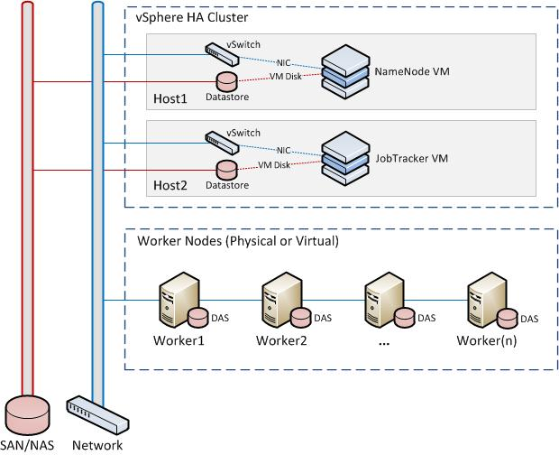
vSphere : VMs are managed

Slide 14
“Canary” monitoring
IN-VM Monitor daemon for each service
NameNode: process, ports, http, DFS operations
JobTracker: process, ports, http, JT status + special handling of HDFS state on startup.
Probe failures reported to vSphere
Triggers VM kill and restart
Differentiating hung service from GC pause hard
Notes:
VMWare monitioring is "canary based" -when the bird stops singing, the service is in trouble.
To implement this we have a new service running in the VM that monitors service health, and stops singing when it decides the service is down.
If the service, the OS or the monitor fails, VSphere reacts by restarting the VM. If the host server fails, all VMs on it get restarted elsewhere
One troublespot: hung processes. Socket blocks. Something needs to detect that and make a decision as to when this is a service hang vs a long GC. There is no way pre-Java7 to know this, so it's just down to timeouts.

Slide 15
Defining liveness
kill -0 `cat <path to .pid file>`
Port open <hostname, port>
HTTP GET <URL, response code range>
DFS list <filesystem, path>
DFS out of safe mode (filesystem)
JT cluster status <hostname, port>
JT out of safe mode <hostname, port>

Slide 16
Monitoring Lifecycle
dependencies
block for upstream services e.g. JT on HDFS
all dependencies live
halt
booting
wait for probes live; fail fast on live → fail
halt
all probes live
boot timeout
failure of live probe
live
check all probes until halted or probe failure
halt
probe failure probe timeout
halted
failed
60s after heartbeats stop, vSphere restarts VM
unhook from vSphere
immediate process exit
Notes:
This is the state machine used to monitor a service. All the time the state machine is not terminated heartbeats are being sent to vSphere every 10s.
Underneath that we have a model of a service blocking for (remote) services before even starting,
booting -which waits for all probes to go live in a bounded time, and fails fast if any live probe reverts
live - everything must respond, timeouts of a probe are picked up too.
halted -a graceful unhook from vSphere, so that heartbeat stopping isn't picked up

Slide 17
RedHat HA Linux
ToR Switch
NN IP
Name Node
DataNode
DataNode
IP1
NN IP
Name Node
DataNode
DataNode
IP2
2NN IP
2ary Name Node
DataNode
DataNode
IP3
JT IP
(Job Tracker)
DataNode
DataNode
IP4
HA Linux: heartbeats & failover

Slide 18
Linux HA Implementation
Replace init.d script with “Resource Agent” script
Hook up status probes as for vSphere
Detection & handling of hung process hard
Test in virtual + physical environments
Testing with physical clusters
ARP trouble on cross-switch failover -don't
Thank you RedHat HA team!

Slide 19
Yes, but does it work?
public void testKillHungNN() {
assertRestartsHDFS {
nnServer.kill(19,
"/var/run/hadoop/hadoop-hadoop-namenode.pid")
}
}
Groovy JUnit tests “chaos” library to work with remote hosts and infrastructures

Slide 20
And how long does it take?
60 Nodes, 60K files, 6 million blocks, 300 TB raw storage – 1-3 minutes
Failure detection and Failover – 0.5 to 2 minutes
Namenode Startup (exit safemode) – 30 sec
180 Nodes, 200K files, 18 million blocks, 900TB raw storage – 2-4 minutes
Failure detection and Failover – 0.5 to 2 minutes
Namenode Startup (exit safemode) – 110 sec
vSphere: add 60s for OS bootup.
Cold Failover is good enough for small/medium clusters
Notes:
One question is "how long does this take"
For clusters of under a few hundred machines, with not that much of an edit log to replay, failure detection dominates the time.
vSphere is the slowest there as it has to notice that the monitor has stopped sending heartbeats (~60s), then boot the OS (~60s) before bringing up the NN. This is why it's better for smaller clusters.
LinuxHA fails over faster; if set to poll every 10-15 s then failover begins within 20s of the outage.

Slide 21
“Full Stack”: IPC client
Configurable retry & time to block
ipc.client.connect.max.retries dfs.client.retry.policy.enabled
Set in core-site.xml for automatic pickup.
Failure-aware applications can tune/disable
Blocking works for most clients

Slide 22
Job Tracker Resilience
“Safe Mode”
rejects new submissions
does not fail ongoing Jobs, blacklist Task Trackers
FS monitoring and automatic safe mode entry: mapreduce.jt.hdfs.monitor.enable
Queue rebuild on restart mapreduce.jt.hdfs.monitor.enable
Job Submission Client to retry: mapreduce.jobclient.retry.policy.enabled

Slide 23
Testing full stack functionality
Run existing test suites against a cluster being killed repeatedly: MapReduce, HBase, Pig
Specific test jobs performing DFS operations from inside MapReduce jobs to stress MR layer
Results:
NN outages did not cause failures
two unrelated bugs in HDFS were found;

Slide 24
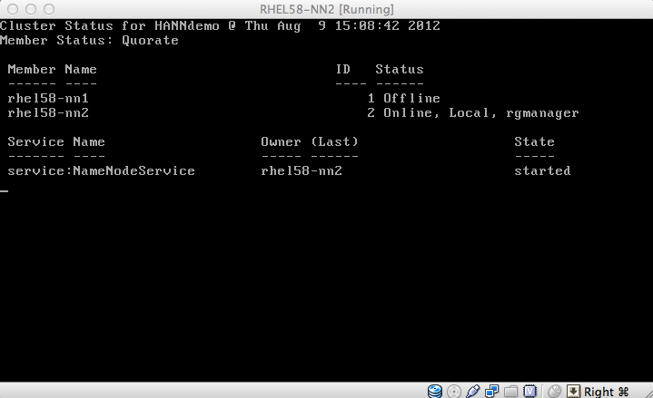
Putting it all together: Demo

Slide 25
vSphere versus RedHat HA
vSphere ideal for small clusters
one VM/service
less physical hosts than service VMs
Obvious choice for sites with vSphere HA
RedHat HA great for large clusters
turns a series of master nodes into a pool of servers with floating services & IP Addresses
downgrades “outages” to “transient events”
Consider RedHat HA for all large clusters

Slide 26
HA in Hadoop HDFS 2

Slide 27
Hadoop 2.0 HA
Zoo- Keeper
Failure- Controller
NN
DataNode
Active
Standby
Active
IP1
Zoo- Keeper
Active
NN
DataNode
Failure- Controller
Standby
Standby
Active
Zoo- Keeper
IP2
Block reports to both NNs; Failure Controllers & Zookeeper co-ordinate

Slide 28
When will HDFS 2 be ready?
Moving from alpha to beta
Notes:
The risk here isn't just the failover, it's all the other changes that went into HDFS 2; the bug reporting numbers for HDFS 2 are way down on the previous releases, which means that it was either much better, or hasn't been tested enough.
the big issue here is that the data in your HDFS cluster may be one of the most valuable assets of an organization, you can't afford to lose it. It's why it's good to be cautious with any filesystem, be it linux or a layer above.

Slide 29
Moving forward
Retry policies for all remote client protocols/libraries in the stack.
Dynamic (zookeeper?) service lookup
YARN needs HA of Resource Manager, individual MR clusters
“No more Managers”

Slide 30
Single Points of Failure
There's always a SPOF
Q. How do you find it?
A. It finds you

Slide 31
Questions?
hortonworks.com
we are hiring!

