Slide 1

Apache
Cloud Computing Edition
Steve Loughran
Julio Guijarro
Robert Burrell Donkin
Notes:
This is a talk on application architecture for the cloud.

Slide 2
Why move to the cloud?
Good
Cost
Outsourcing hardware problems
Move from capital to pay-as-you-go
To handle Petabytes of data
For a business plan that might work
Bad: to avoid the operations team
1 April 2009

Slide 3
What is a cloud application?
The program that is run
The code/data needed to run it in a datacentre
Anything needed to configure, monitor and manage the system
1 April 2009
Notes:
We've often tended to split the "application" from the installation, because that installation usually included buying hardware, connecting it together, etc. Not any more. Now the servers and storage are just procedural or declarative instructions in a different file in the repository. Which means you need to look at everything together.

Slide 4
This is not a cloud application
Enterprise Java on Highly Available servers
1 April 2009
Notes:
You can still run it on the cloud if you host it in a VM infrastructure that make the "cloud" look like physical machines. This is what enterprises do as it reduces hardware costs of maintaining machines for single apps, especially ones that don't get used very often. But you still have software maintenance and OS update costs, the latter is now a function of the #of OS images you have, not the #of physical machines

Slide 5
JavaEE is not a cloud application
1 April 2009
Notes:
Not picking on any particular server here; just the small-cluster architecture which Java EE excelled at.
You have lots of beans to hide complexity of databases and web services from your developer, as XML and SQL are considered too complicated for them.
The database handles replication, RAID-5 delivers data security; the app server keeps the beans consistent
WS-* and IIOP delivers good integration with other applications in the infrastructure that are somewhat controlled. It is possible to get all the architects into a phone conference and for them to agree on which WS-* specs to use, what the single-signon protocol will be (often WinNT auth, maybe via LDAP), etc.
In house -your customers can't walk away. Externally, you may have scale problems at times of popularity.

Slide 6
Things must change!
Web UI for users, affiliates, marketing, operations
Agile machine management is part of the API
Scale up -and down
Live upgrade of running system
Persistence with key-value stores
A Petabyte filesystem is part of the application
MapReduce jobs close the loop
Developers deploy to the cloud to test
1 April 2009
Notes:
Everything needs to be agile

Slide 7

The agile will survive

Slide 8
1 April 2009
Notes:
This is a cloud application.
Scale: many users -or down to nearly none.
Collaboration: if there are live feeds of all friends/colleagues, it is hard to shard
Business model may include affiliate applications -web based
Management, developers, ops behind the scenes
Pay as you go infrastructure

Slide 9
EC2 as the cloud provider
S3 for persistence, public downloads
SimpleDB provides key-value storage, but query costs unpredictable.
Typica for EC2 services API
http://code.google.com/p/typica/
AWS IP rental or Dyndns for hostnames
No billing or test APIs
No image management services
No standard Apache Stack
1 April 2009
Notes:
Image management: provide a list of RPMs or other requirements of a machine, send a message with this list to a provider, get back the machine address to log in to. People like rightscale and similar are providing this for a fee, but AWS could do this just as easily. They are not doing it yet, but if your startup's business model depends on AWS not doing it, then your business model is the same as those people who provided add-ons for Windows 3.1. Provided. The only ones left now provide extra security for the OS, because MS now do nearly everything else themselves.
Typica is a good Java front end API to this service

Slide 10
Sun, IBM, HP as the cloud providers
S3 -like filestore
EC2 and Sun RESTy APIs
Unknown queue and keystore services
More secure networking?
Billing and monitoring?
Testing?
Image management services?
No standard Apache Stack
1 April 2009
Notes:
Who else can do this? Vendors with capital can afford to roll out infrastructure. Different business model from Amazon (who invest in datacentres for the xmas peak), they are all driven by a need to sell hardware into a world where hardware goes into datacentres.

Slide 11
Private cloud
Eucalyptus for deploying Xen images
Various persistence options
Private filestore: HDFS, kfs, Lustre
Kickstart for image management?
No standard Apache Stack
1 April 2009
Notes:
Private clouds are an interesting idea. You can do it today with VMWare, but it uses a different machine API, and is fairly biased towards humans and GUIS.
Eucalyptus is the OSS tool for managing a few thousand servers. "Small" datacentres -but enough for many organisations. The API gives you dynamic machines, but you are left with all the other details.

Slide 12
Whoever owns the API owns the application for its life
Whoever owns the data owns you
1 April 2009
Notes:
Two observations based on the previous years of the PC business. Some people may think of MS and Oracle, but in fact IBM probably invented both of these first, those two companies just executed it better.

Slide 13
Apache Cloud Computing Edition
Diverse mix of high-level technologies
Very large filestore at the bottom :
Hadoop APIs, Java 7 NIO, Fuse, WebDAV
MapReduce phase for post-processing
We need stories for :
persistence, configuration, resource management
A standard Apache Stack!
1 April 2009
Notes:
Here's a different idea. How about Apache becoming the Apache for the cloud, with our own stack, an evolution of what we have today in terms of Apache HTTPD, the Apache Java ecosystem, and what we are doing in other parts of the community?

Slide 14
Front End
The existing Web Front ends should work:
Servlets, JSP, wicket, PSP, grails
(maybe with memcached)
Glue: queues, scatter-gather, tuple-space, events
Everything needs to handle an agile world
Everything needs instrumenting for management
1 April 2009
Notes:
The good news: the front end still works, mostly. Where things get into trouble is if they cache changing hostnames, or contain other assumptions about where data lives on other machines, hard-coded JDBC paths, etc.
Better Glue
Queues. AWS provides something built in; the competitors need them too. Again, standard APIs are nice here.
Scatter-Gather. Doug Cutting can explain what this is. It probably work bests on networks with multicast, which means not-on-EC2.
Tuple-spaces. People who remember JINI and Java Spaces may remember these, but they are in fact quite useful. Any machine can assert a fact into the T-Space, other machines can look for them, act on them. A nice way to loosely couple machines. We use this for some of our resource management, though again multicast and assumptions about linear clocks can create fun in a virtual world.

Slide 15






Persistence
SimpleJPA
?
PNUTS/Sherpa
Cassandra
1 April 2009
Notes:
This is a real troublespot. Because one of the goals of classic O/R mapping was 1:1 mapping of entries in a db to Java objects. You can't get that if you scale out the front to 200 machines, you have to deal with eventual consistence, and have more of a model of read-only views versus things you can write back to.
Options
-JBDC-like API to Hadoop: Hive
-Things built atop Hadoop DFS: HBase, Hypertable, Cassandra
-Other cloud-scale apache code: CouchDB
-layers to hide cloud-specific databases, such as SimpleDB and SimpleJPA
do we want keystore databases to be retrofitted to look like RDMS systems, or should we do something cleaner, with less locking and more eventual consistency?
What should the back end be?
What makes a good API for Java, other languages
Steve: integration with Hadoop makes database work inside MR jobs easier, but we also need fast read-access (=fast DB or slow DB+memcached), and sometimes you really do need transactions.

Slide 16
Everything needs a REST API
REST is the long-haul API -why have a separate internal one?
JAX-RS is very nice:
CXF, Jersey, RESTEasy, Restlet implement it
Client API evolving
Http Components/HttpClient can be the foundation for the Apache client; needs AWS support.
1 April 2009
Notes:
What is nice about JAX-RS is that it is an API that is nice to use (unlike, say, JAX-WS), and there are multiple implementations. I can and should be the foundation for all RESTy service endpoints in Apache unless you are tightly coupled to existing applications
Restlet is worth a play with, even though Apache folk won't like the license. It has a very clean transport-neutral model, one in which the client API is a mirror of the server one, as opposed to the java.net and Servlet APIs, that are completely different.

Slide 17
Events and messages
"disk 3436 is failing"
Bluetooth phone 04:5a:1f:c2:87:91 entered
cell 56 in London NW2
Queued purchases with card numbers
internal and external events:
reliability, scalability, triggered actions
1 April 2009
Notes:
Eventing and messaging. Are they the same or different?
What to do with them: some you can queue, others should trigger immediate actions, others can be dealt with later, just add more data to the filestore for mining. That phone, for example: is it a triggered action, or is it something important.

Slide 18
Resource Management?
HA resource manager to monitor front end/back end load and request/release machines on demand
Kill unhealthy nodes (liveness, performance)
Programmable policies (money vs. load)
Choreograph live upgrade/migration
Resource Manager as a service
1 April 2009
Notes:
Resource Management is the problem of allocating enough machines for demand and your budget, but not too many. You need to create machines when load is high (within constraints), free them when low, but taking into account rules about minimum per-hour cost of machines; time to instantiate.
Also need to be able to shut down webapps in a way that they can handle. If they are crash-only this is easy, but if not, then the RM needs to shut them down gracefully.
Health also needs monitoring. In a VM-world, killing and reinstantiating is powerful -it avoids problems with overloaded racks, it avoids problems with one specific machine in the rack. But: IPAddresses can change, restart costs higher. Best to have the RM manage this gracefully with a restart followed by a full VM-termination.
The RM does not need to be something every single user of a cloud needs to host for them selves

Slide 19


Configuration & Management
LDAP (and APIs)
key-value stores
SmartFrog moving to Apache license
What is Spring planning in this area?
1 April 2009
Notes:
You need to worry a lot more about configuration here, because everything is agile. No more hard coded hostnames in Java pages, JDBC URLs with server hostnames in them in your jJava source

Slide 20


Development
How to build and test in this world?
How to step through a program running on a remote datacentre?
How to control testing costs?
1 April 2009
Notes:
I don’t want to start an Ant vs Maven debate here, as I'm stepping away from that. I will say that Eclipse is becoming the standard API, which is good in one way -one thing to target UI plugins for- bad in others. Good for uniformity, bad if you find it painful to use.
Testing is very different here. You can create machines on demand, but then your tests run up bills. A good practise here is for the developers to start their cluster when they come in in the morning; for it to be shut down when they go idle. And to use a separate credit card from production, so if they go over budget, your service doesn’t go off-line.

Slide 21
Testing -your first terabyte of data
protected void map(Text key, Text test, Context context)
throws IOException, InterruptedException {
TestResult result = new TestResult();
Class<?> testClass = loadClass(context, test);
Test testSuite = JUnitMRUtils.extractTest(testClass);
TestSuiteRun tsr = new TestSuiteRun();
result.addListener(tsr);
testSuite.run(result);
for (SingleTestRun singleTestRun : tsr.getTests()) {
context.write(new Text(singleTestRun.name),
singleTestRun);
}
}
Lots of opportunities here!
1 April 2009
Notes:
Testing is not merely "different", it is an opportunity to use data mining within your own process. Now you can keep all the old test run info, compare performance over time, use CM tools to explore more of the configuration space (which cluster/app options give best value for money), integrate this with the test runs.
We need:
-test runners to feed data into Hadoop filesystems
-analysis algorithms
-presentation of results.
Last.fm have been doing lots of this stuff; we've been playing with different Hadoop configs, with automated configuration generators on the plans.
Here is something else of mine, something that runs a list of tests. takes a text file listing all test suites/classes to execute, each is a separate job. The results are pushed back as a new entry for every test in the suite.

Slide 22
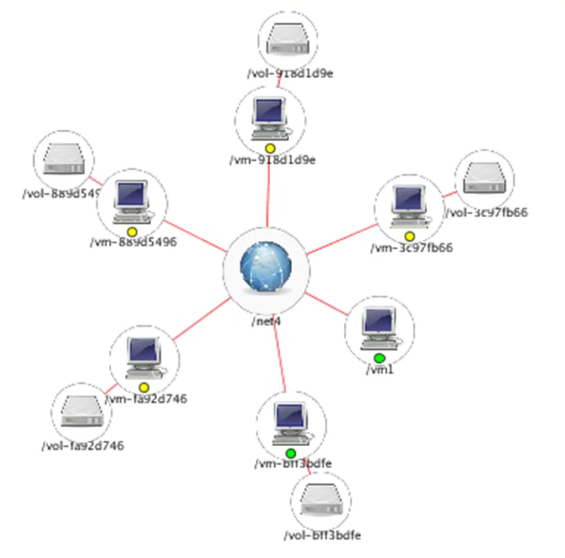
Testing -the infrastructure can help
Pseudo-RNG driven cluster configuration
1 April 2009
Notes:
This is how HP tests some of its infrastructure-on-demand services: with a pseduo-RNG configuration generator generating more of the configuration space than humans could do themselves.

Slide 23
Cirrus Cloud Testbed?
HP, Intel, Yahoo!, universities
Heterogeneous, multiple datacentres
Offering datacentre time, not specific apps
Low-level API for physical machines
Cloud-API for virtual machines
Paying customers? No, not yet.
Open source projects? We hope so
1 April 2009
Notes:
What's up with the HP-Intel-Yahoo! Cirrus testbed?
Cirrus is more than just Hadoop and friends in a datacentre -it is low-level physical machine access letting you install physical OS images for periods of time, and layers on top. Hadoop is one key application, but not the only one.
We're hoping that we can get OSS time in here too -because it helps ensure our code runs across multiple machines
HP: 1000 cores, 256+ boxes, some disk heavy, some RAM-heavy

Slide 24
What next?
Apache has the core of a Cloud Computing stack
How do we take this and:
integrate the various pieces?
extend them where appropriate?
provide an alternative to AppEngine and Azureus?
1 April 2009

Slide 25
Call to action
Stop writing EJB apps
Start collecting as much data as you can and feeding that MapReduce mining-phase.
Design for: distributed not-quite-Posix filesystems, message queues, name-value databases
Apache: let's build our own cloud platform
1 April 2009

Slide 26

Let's build Apache's Cloud Stack

Slide 27
VM Image Management
AMI Image sprawl: 10%/month
Old images are a security risk
The whole PXE+Kickstart process is built for physical machines.
This is not an Apache problem, but we'll need to work with the OS vendors & others to integrate
1 April 2009
Notes:
Public EC2 images are growing at 10% month -nice earner for Amazon.
Brings on lots of maintenance costs to users, plus security risks.
For short-lived images, better to have tools to create OS images from a list of deb/RPM files and any other state changes -you needed to automate that system config anyway, didn't you?
This is not the Apache focus point -but we need to work with people doing this as their business plan is keeping our cloud services up and running.

Slide 28
HDFS improvements
Scale, availability, small files: hierarchical namenodes?
Could it be a general purpose media store?
For web sites?
1 April 2009
Notes:
Real security heres hard. What is being done there is adequate for a network where you trust everyone.

Slide 29
Amazon EC2
Public Internet
$
$
$
$
Host
Host
AMI
(Xen VM)
AMI
(Xen VM)
AMI
(Xen VM)
AMI
(Xen VM)
$
/mnt
/mnt
/mnt
/mnt
Fast (free) network
S3 Storage
free access; slow initial read time
pay per GET;
per megabyte
1 April 2009

Slide 30
1 April 2009

